Slide 1
6
Functions and an Introduction to Recursion

Slide 2
Form ever follows function.
  Louis Henri Sullivan
E pluribus unum. (One composed of many.)
  Virgil
O! call back yesterday, bid time return.
  William Shakespeare
Call me Ishmael.
  Herman Melville

Slide 3
When you call me that, smile!
  Owen Wister
Answer me in one word.
  William Shakespeare
There is a point at which methods devour themselves.
  Frantz Fanon
Life can only be understood backwards; but it must be lived forwards.
  Soren Kierkegaard

Slide 4
OBJECTIVES
In this chapter you’ll learn:
To construct programs modularly from functions.
To use common math functions available in the C++ Standard Library.
To create functions with multiple parameters.
The mechanisms for passing information between functions and returning results.
How the function call/return mechanism is supported by the function call stack and activation records.
To use random number generation to implement game-playing applications.
How the visibility of identifiers is limited to specific regions of programs.
To write and use recursive functions, i.e., functions that call themselves.

Slide 5
6.1 Introduction
6.2 Program Components in C++
6.3 Math Library Functions
6.4 Function Definitions with Multiple Parameters
6.5 Function Prototypes and Argument Coercion
6.6 C++ Standard Library Header Files
6.7 Case Study: Random Number Generation
6.8 Case Study: Game of Chance and Introducing enum
6.9 Storage Classes
6.10 Scope Rules
6.11 Function Call Stack and Activation Records
6.12 Functions with Empty Parameter Lists

Slide 6
6.13 Inline Functions
6.14 References and Reference Parameters
6.15 Default Arguments
6.16 Unary Scope Resolution Operator
6.17 Function Overloading
6.18 Function Templates
6.19 Recursion
6.20 Example Using Recursion: Fibonacci Series
6.21 Recursion vs. Iteration
6.22 (Optional) Software Engineering Case Study: Identifying Class Operations in the ATM System
6.23 Wrap-Up

Slide 7
6.1 Introduction
Divide and conquer technique
  Construct a large program from small, simple pieces (e.g., components)
Functions
  Facilitate the design, implementation, operation and maintenance of large programs
C++ Standard Library math functions

Slide 8
6.2 Program Components in C++
C++ Standard Library
  Rich collection of functions for performing common operations, such as:
    Mathematical calculations
    String manipulations
    Character manipulations
    Input/Output
    Error checking
  Provided as part of the C++ programming environment

Slide 9
Software Engineering Observation 6.1
Read the documentation for your compiler to familiarize yourself with the functions and classes in the C++ Standard Library.

Slide 10
6.2 Program Components in C++ (Cont.)
Functions
  Called methods or procedures in other languages
  Allow programmers to modularize a program by separating its tasks into self-contained units
    Statements in function bodies are written only once
      Reused from perhaps several locations in a program
      Hidden from other functions
      Avoid repeating code
    Enable the divide-and-conquer approach
    Reusable in other programs
    User-defined or programmer-defined functions

Slide 11
Software Engineering Observation 6.2
To promote software reusability, every function should be limited to performing a single, well-defined task, and the name of the function should express that task effectively. Such functions make programs easier to write, test, debug and maintain.

Slide 12
Error-Prevention Tip 6.1
A small function that performs one task is easier to test and debug than a larger function that performs many tasks.

Slide 13
Software Engineering Observation 6.3
If you cannot choose a concise name that expresses a function’s task, your function might be attempting to perform too many diverse tasks. It is usually best to break such a function into several smaller functions.

Slide 14
6.2 Program Components in C++ (cont.)
Function (Cont.)
  A function is invoked by a function call
    Called function either returns a result or simply returns to the caller
    Function calls form hierarchical relationships

Slide 15
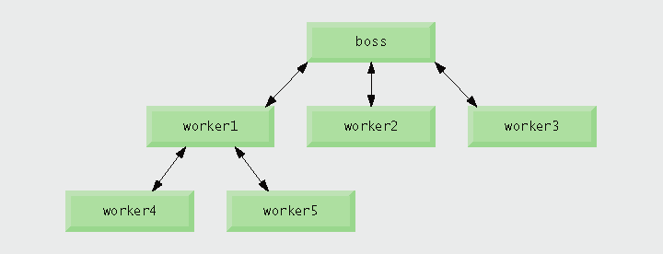
Fig. 6.1 | Hierarchical boss function/worker function relationship.

Slide 16
6.3 Math Library Functions
Global functions
  Do not belong to a particular class
  Have function prototypes placed in header files
    Can be reused in any program that includes the header file and that can link to the function’s object code
  Example: sqrt in <cmath> header file
    sqrt( 900.0 )
    All functions in <cmath> are global functions

Slide 17
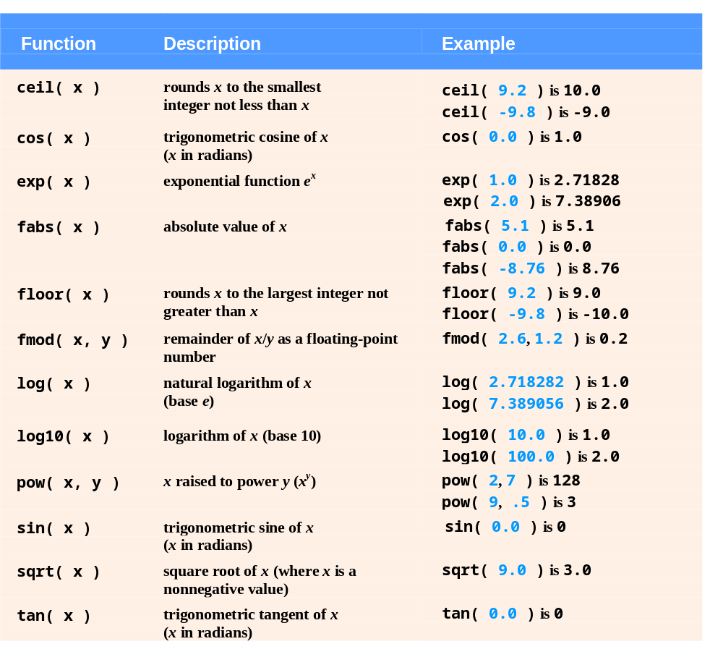
Fig. 6.2 | Math library functions.

Slide 18
6.4 Function Definitions with Multiple Parameters
Multiple parameters
  Functions often require more than one piece of information to perform their tasks
  Specified in both the function prototype and the function header as a comma-separated list of parameters

Slide 19
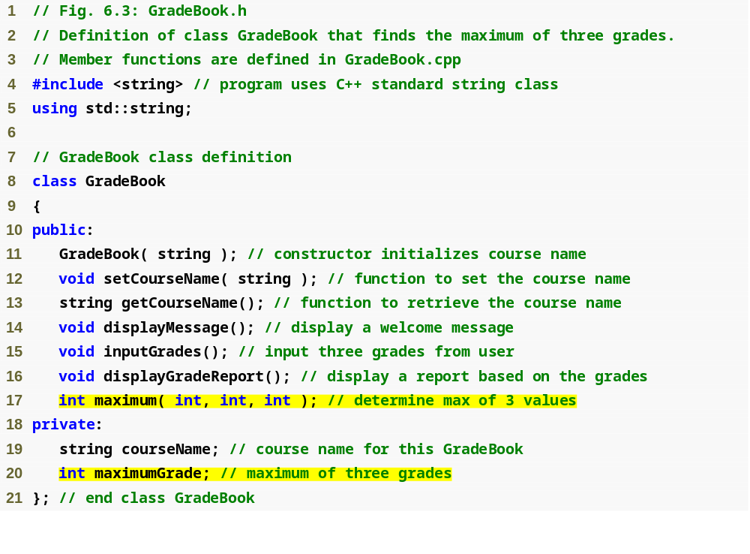
Outline
GradeBook.h
(1 of 1)
Prototype for a member function that takes three arguments
Data member to store maximum grade

Slide 20
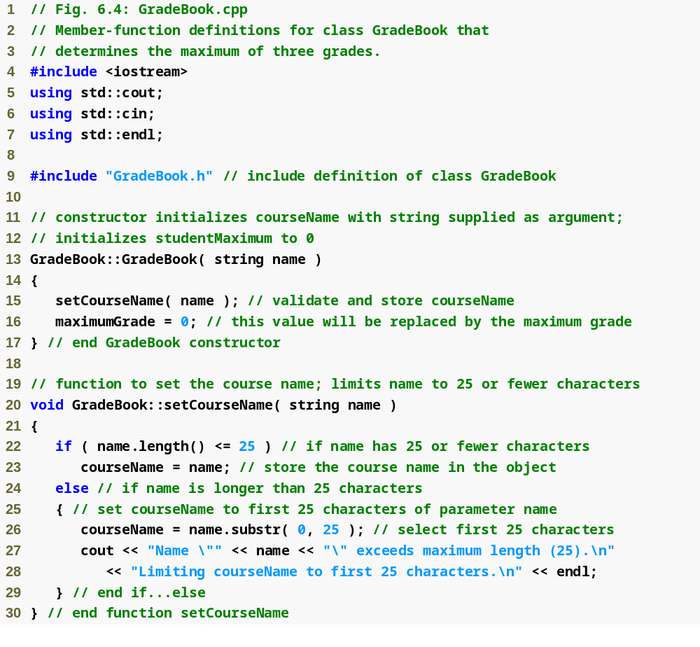
Outline
GradeBook.cpp
(1 of 3)

Slide 21
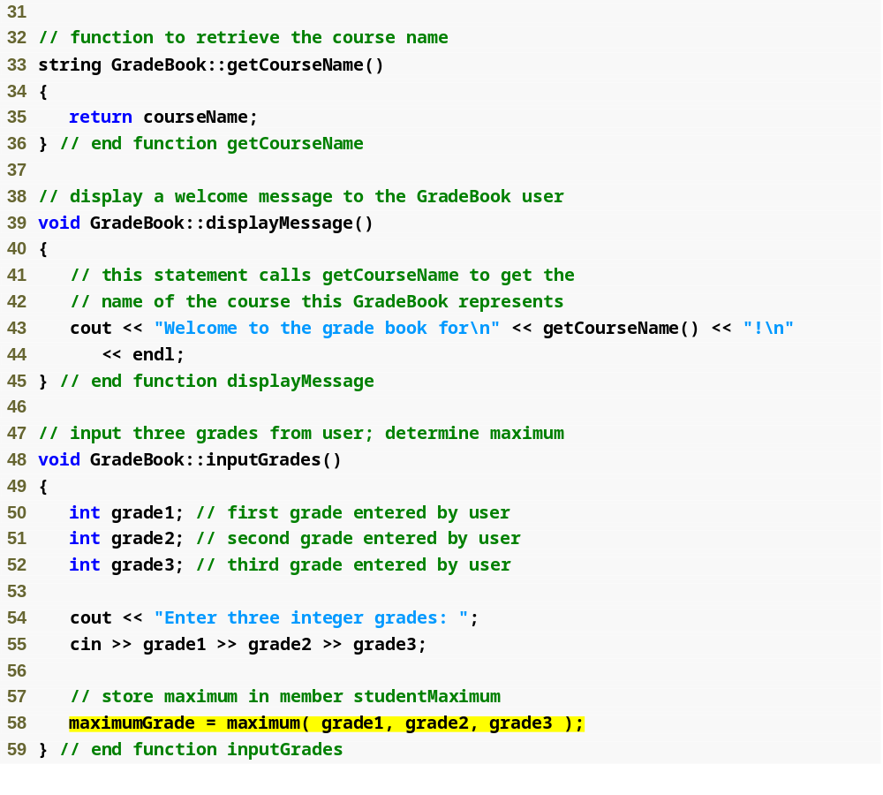
Outline
GradeBook.cpp
(2 of 3)
Call to function maximum passes three arguments

Slide 22
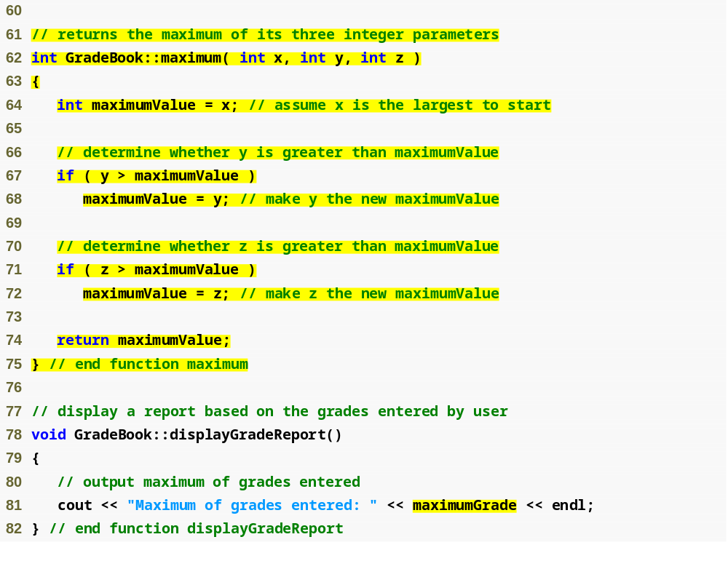
Outline
maximum member function header
Comma-separated parameter list
GradeBook.cpp
(3 of 3)
Returning a value to the caller

Slide 23
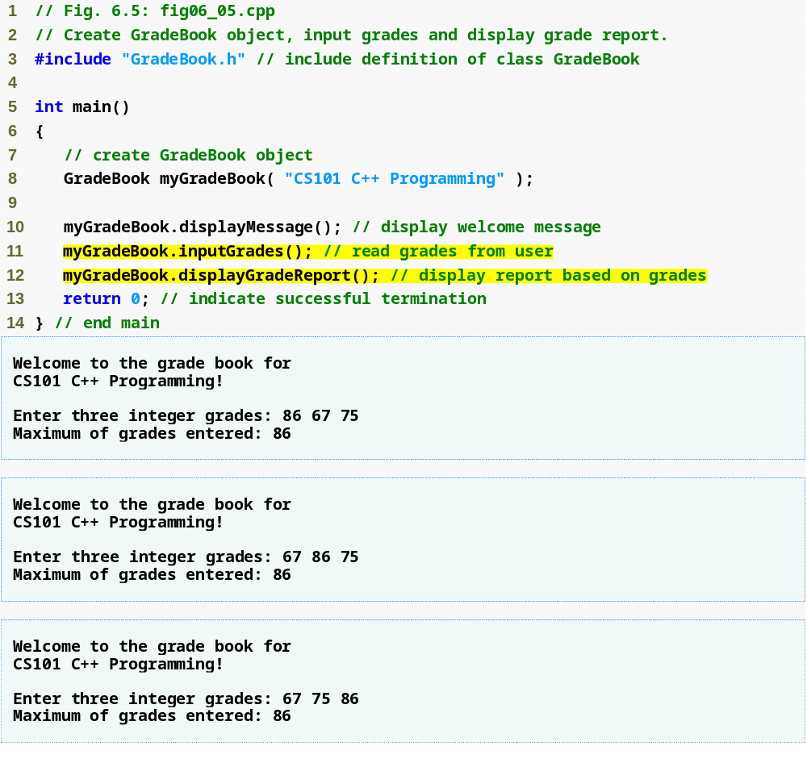
Outline
fig06_05.cpp
(1 of 1)

Slide 24
Software Engineering Observation 6.4
The commas used in line 58 of Fig. 6.4 to separate the arguments to function maximum are not comma operators as discussed in Section 5.3. The comma operator guarantees that its operands are evaluated left to right. The order of evaluation of a function’s arguments, however, is not specified by the C++ standard. Thus, different compilers can evaluate function arguments in different orders. The C++ standard does guarantee that all arguments in a function call are evaluated before the called function executes.

Slide 25
6.4 Function Definitions with Multiple Parameters (Cont.)
Compiler uses a function prototype to:
  Check that calls to the function contain the correct number and types of arguments in the correct order
  Ensure that the value returned by the function is used correctly in the expression that called the function
Each argument must be consistent with the type of the corresponding parameter
  Parameters are also called formal parameters

Slide 26
Portability Tip 6.1
Sometimes when a function’s arguments are more involved expressions, such as those with calls to other functions, the order in which the compiler evaluates the arguments could affect the values of one or more of the arguments. If the evaluation order changes between compilers, the argument values passed to the function could vary, causing subtle logic errors.

Slide 27
Error-Prevention Tip 6.2
If you have doubts about the order of evaluation of a function’s arguments and whether the order would affect the values passed to the function, evaluate the arguments in separate assignment statements before the function call, assign the result of each expression to a local variable, then pass those variables as arguments to the function.

Slide 28
Common Programming Error 6.1
Declaring method parameters of the same type as double x, y instead of double x, double y is a syntax error—an explicit type is required for each parameter in the parameter list.

Slide 29
Common Programming Error 6.2
Compilation errors occur if the function prototype, function header and function calls do not all agree in the number, type and order of arguments and parameters, and in the return type.

Slide 30
Software Engineering Observation 6.5
A function that has many parameters may be performing too many tasks. Consider dividing the function into smaller functions that perform the separate tasks. Limit the function header to one line if possible.

Slide 31
6.4 Function Definitions with Multiple Parameters (Cont.)
Three ways to return control to the calling statement:
  If the function does not return a result:
    Program flow reaches the function-ending right brace or
    Program executes the statement return;
  If the function does return a result:
    Program executes the statement return expression;
      expression is evaluated and its value is returned to the caller

Slide 32
6.5 Function Prototypes and Argument Coercion
Function prototype
  Also called a function declaration
  Indicates to the compiler:
    Name of the function
    Type of data returned by the function
    Parameters the function expects to receive
      Number of parameters
      Types of those parameters
      Order of those parameters

Slide 33
Software Engineering Observation 6.6
Function prototypes are required in C++. Use #include preprocessor directives to obtain function prototypes for the C++ Standard Library functions from the header files for the appropriate libraries (e.g., the prototype for math function sqrt is in header file <cmath>; a partial list of C++ Standard Library header files appears in Section 6.6). Also use #include to obtain header files containing function prototypes written by you or your group members.

Slide 34
Common Programming Error 6.3
If a function is defined before it is invoked, then the function’s definition also serves as the function’s prototype, so a separate prototype is unnecessary. If a function is invoked before it is defined, and that function does not have a function prototype, a compilation error occurs.

Slide 35
Software Engineering Observation 6.7
Always provide function prototypes, even though it is possible to omit them when functions are defined before they are used (in which case the function header acts as the function prototype as well). Providing the prototypes avoids tying the code to the order in which functions are defined (which can easily change as a program evolves).

Slide 36
6.5 Function Prototypes and Argument Coercion (Cont.)
Function signature (or simply signature)
  The portion of a function prototype that includes the name of the function and the types of its arguments
    Does not specify the function’s return type
  Functions in the same scope must have unique signatures
    The scope of a function is the region of a program in which the function is known and accessible

Slide 37
Common Programming Error 6.4
It is a compilation error if two functions in the same scope have the same signature but different return types.

Slide 38
6.5 Function Prototypes and Argument Coercion (Cont.)
Argument Coercion
  Forcing arguments to the appropriate types specified by the corresponding parameters
    For example, calling a function with an integer argument, even though the function prototype specifies a double argument
      The function will still work correctly

Slide 39
6.5 Function Prototypes and Argument Coercion (Cont.)
C++ Promotion Rules
  Indicate how to convert between types without losing data
  Apply to expressions containing values of two or more data types
    Such expressions are also referred to as mixed-type expressions
    Each value in the expression is promoted to the “highest” type in the expression
      Temporary version of each value is created and used for the expression
        Original values remain unchanged

Slide 40
6.5 Function Prototypes and Argument Coercion (Cont.)
C++ Promotion Rules (Cont.)
  Promotion also occurs when the type of a function argument does not match the specified parameter type
    Promotion is as if the argument value were being assigned directly to the parameter variable
  Converting a value to a lower fundamental type
    Will likely result in the loss of data or incorrect values
    Can only be performed explicitly
      By assigning the value to a variable of lower type (some compilers will issue a warning in this case) or
      By using a cast operator

Slide 41
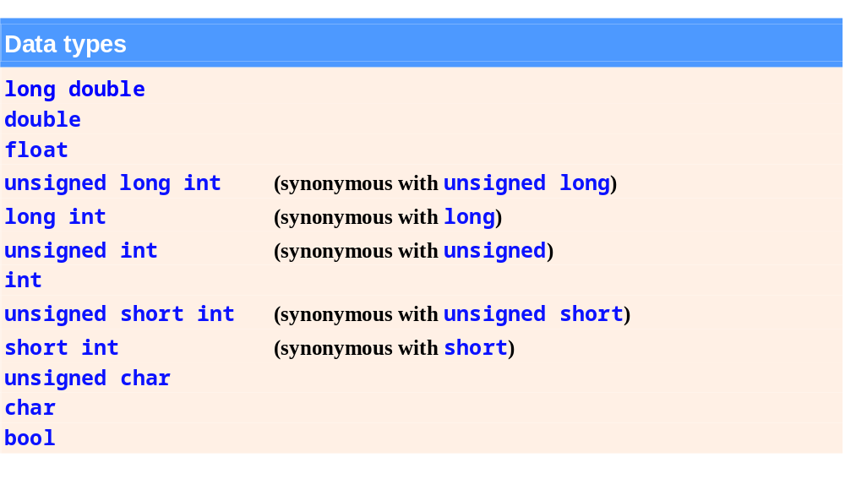
Fig. 6.6 | Promotion hierarchy for fundamental data types.

Slide 42
Common Programming Error 6.5
Converting from a higher data type in the promotion hierarchy to a lower type, or between signed and unsigned, can corrupt the data value, causing a loss of information.

Slide 43
Common Programming Error 6.6
It is a compilation error if the arguments in a function call do not match the number and types of the parameters declared in the corresponding function prototype. It is also an error if the number of arguments in the call matches, but the arguments cannot be implicitly converted to the expected types.

Slide 44
6.6 C++ Standard Library Header Files
C++ Standard Library header files
  Each contains a portion of the Standard Library
    Function prototypes for the related functions
    Definitions of various class types and functions
    Constants needed by those functions
  “Instruct” the compiler on how to interface with library and user-written components
  Header file names ending in .h
    Are “old-style” header files
    Superseded by the C++ Standard Library header files

Slide 45
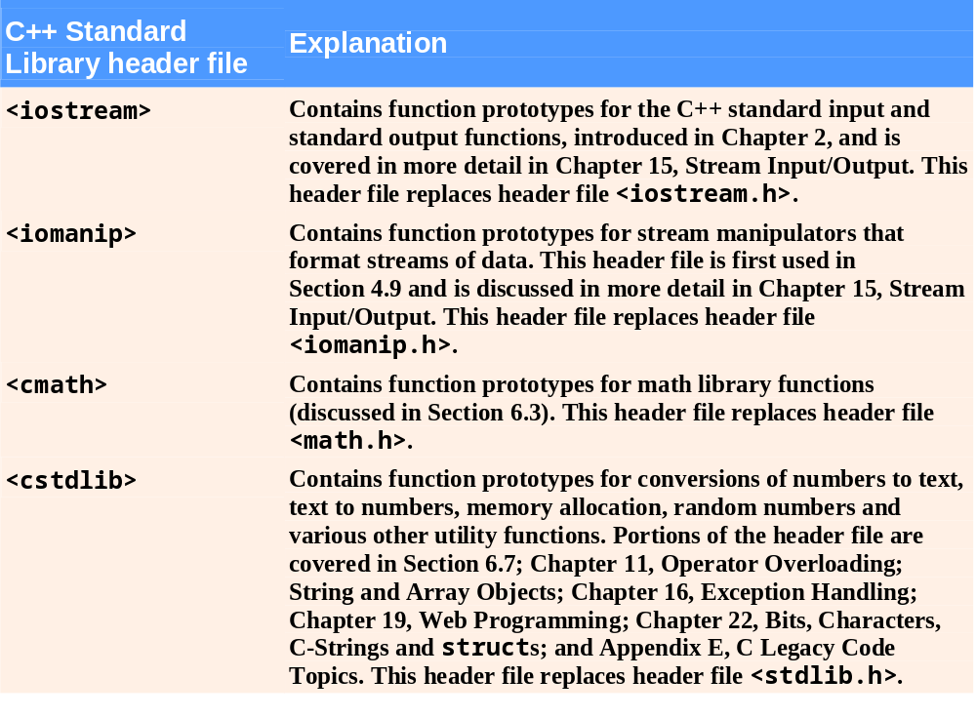
Fig. 6.7 | C++ Standard Library header files. (Part 1 of 4)

Slide 46
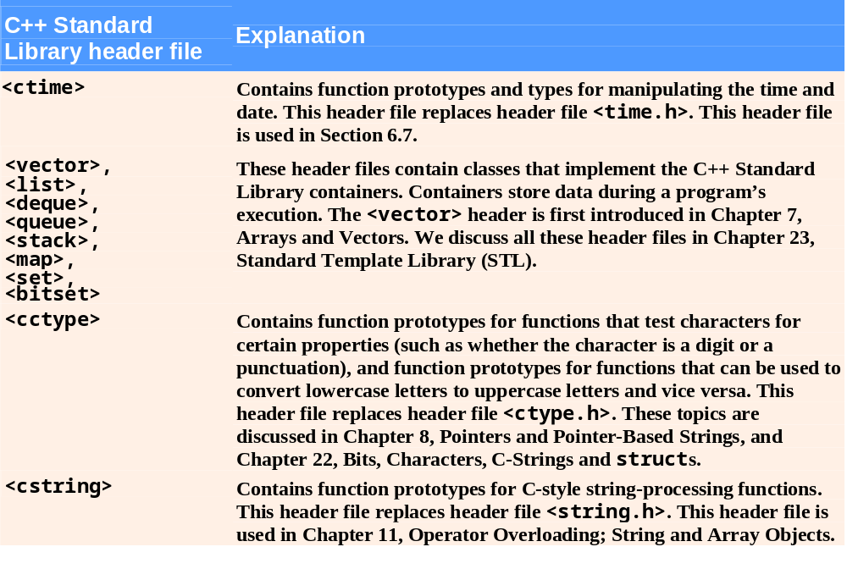
Fig. 6.7 | C++ Standard Library header files. (Part 2 of 4)

Slide 47
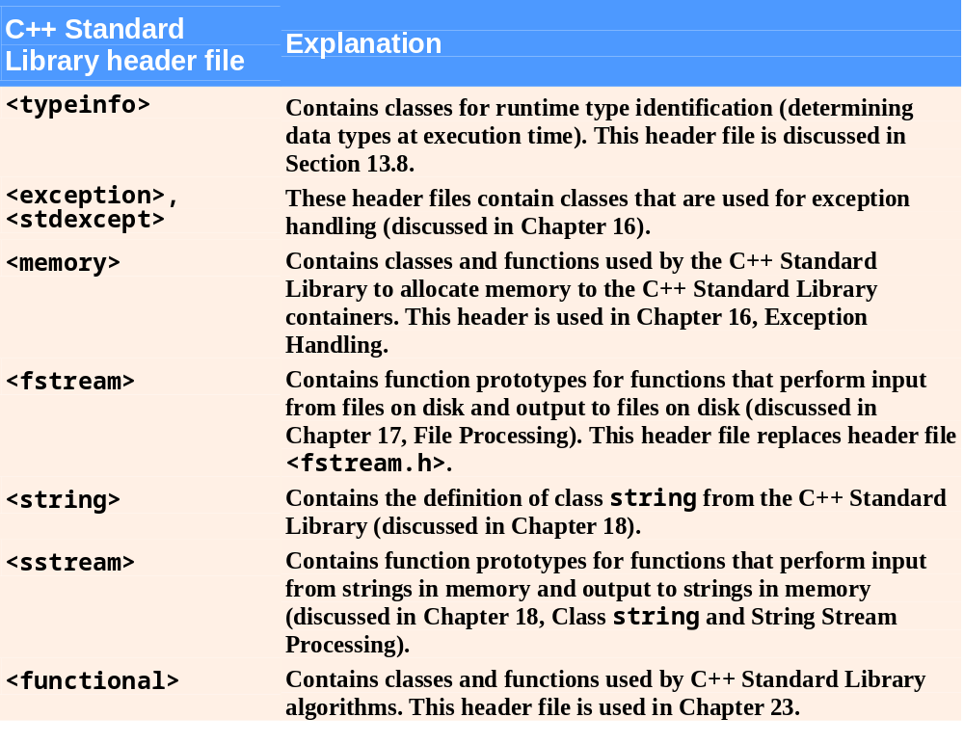
Fig. 6.7 | C++ Standard Library header files. (Part 3 of 4)

Slide 48
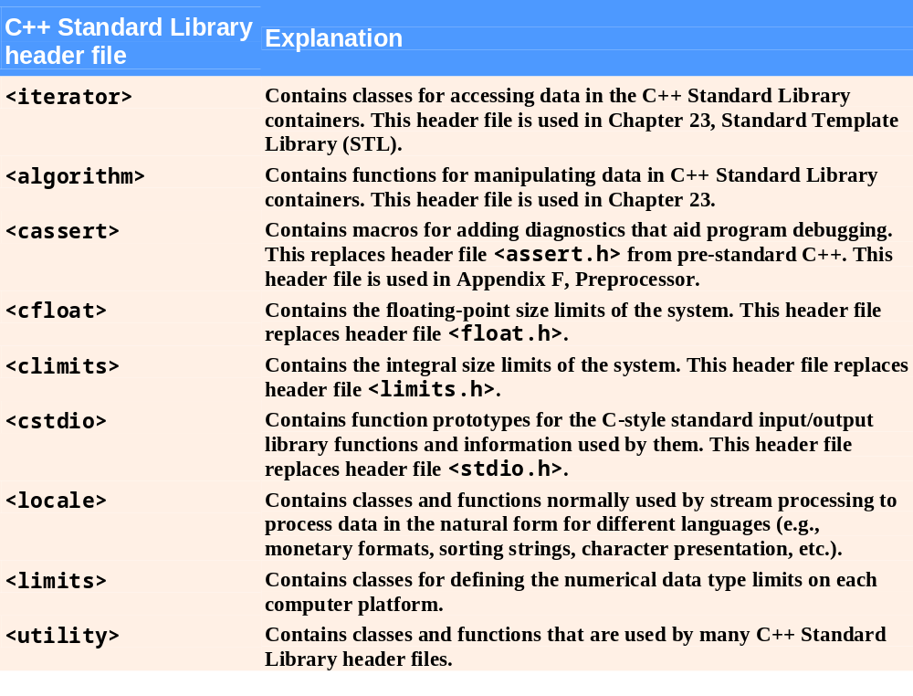
Fig. 6.7 | C++ Standard Library header files. (Part 4 of 4)

Slide 49
6.7 Case Study: Random Number Generation
C++ Standard Library function rand
  Introduces the element of chance into computer applications
  Example
    i = rand();
      Generates an unsigned integer between 0 and RAND_MAX (a symbolic constant defined in header file <cstdlib>)
  Function prototype for the rand function is in <cstdlib>

Slide 50
6.7 Case Study: Random Number Generation (Cont.)
To produce integers in a specific range, use the modulus operator (%) with rand
  Example
    rand() % 6;
      Produces numbers in the range 0 to 5
  This is called scaling, 6 is the scaling factor
  Shifting can move the range to 1 to 6
    1 + rand() % 6;

Slide 51
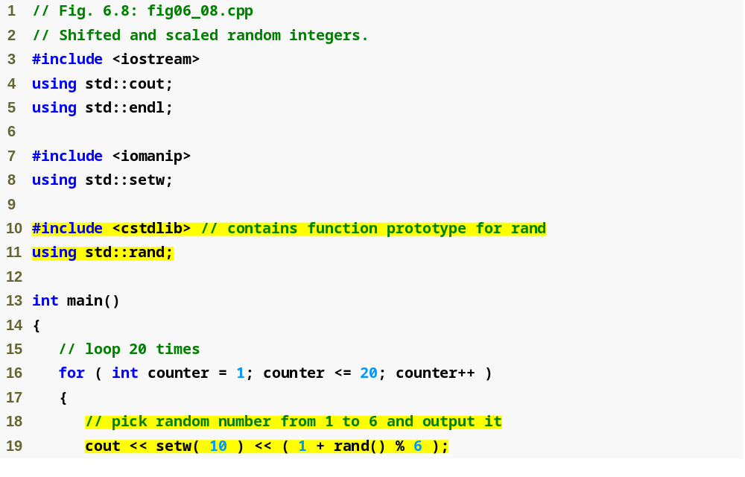
Outline
fig06_08.cpp
(1 of 2)
#include and using for function rand
Calling function rand

Slide 52
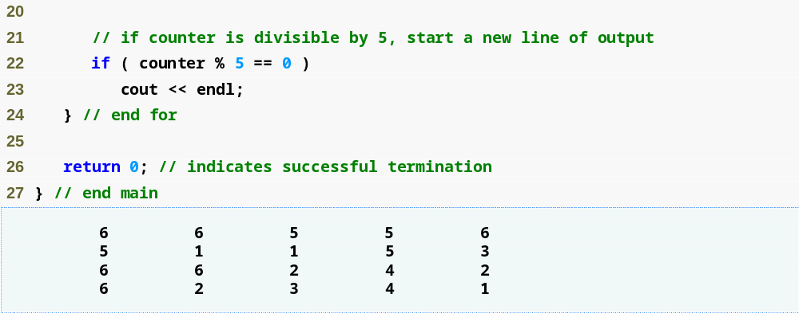
Outline
fig06_08.cpp
(2 of 2)

Slide 53
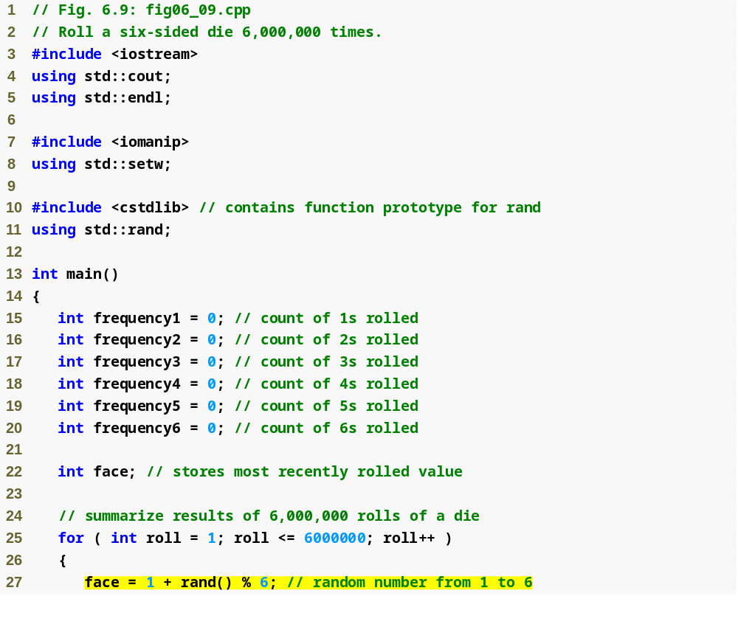
Outline
fig06_09.cpp
(1 of 3)
Scaling and shifting the value produced by function rand

Slide 54
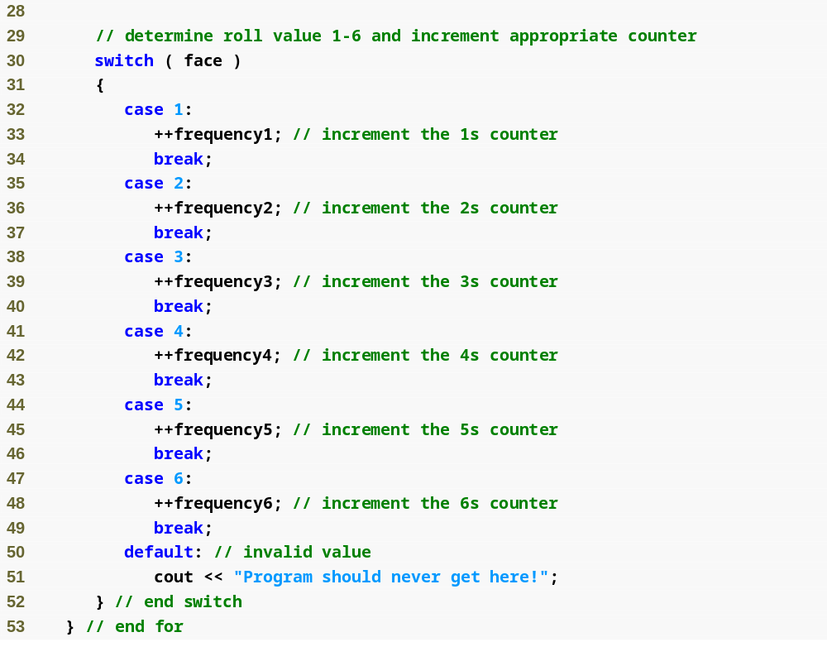
Outline
fig06_09.cpp
(2 of 3)

Slide 55
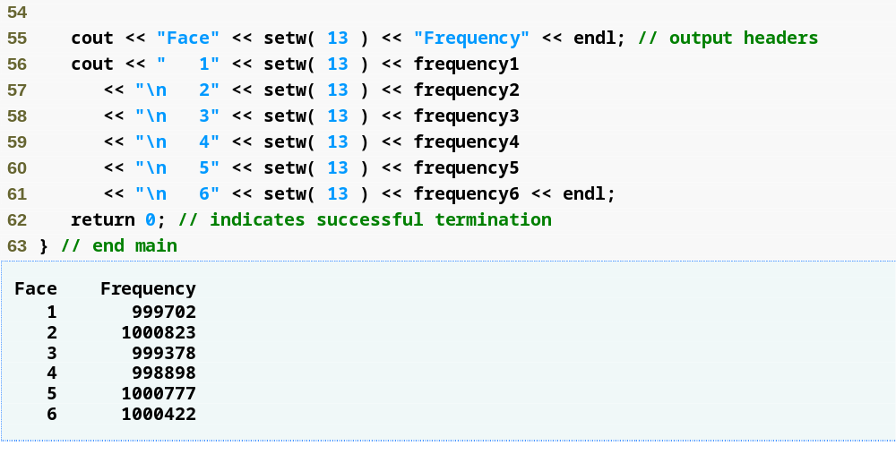
Outline
fig06_09.cpp
(3 of 3)
Each face value appears approximately 1,000,000 times

Slide 56
Error-Prevention Tip 6.3
Provide a default case in a switch to catch errors even if you are absolutely, positively certain that you have no bugs!

Slide 57
6.7 Case Study: Random Number Generation (Cont.)
Function rand
  Generates pseudorandom numbers
  The same sequence of numbers repeats itself each time the program executes
Randomizing
  Conditioning a program to produce a different sequence of random numbers for each execution
C++ Standard Library function srand
  Takes an unsigned integer argument
  Seeds the rand function to produce a different sequence of random numbers

Slide 58
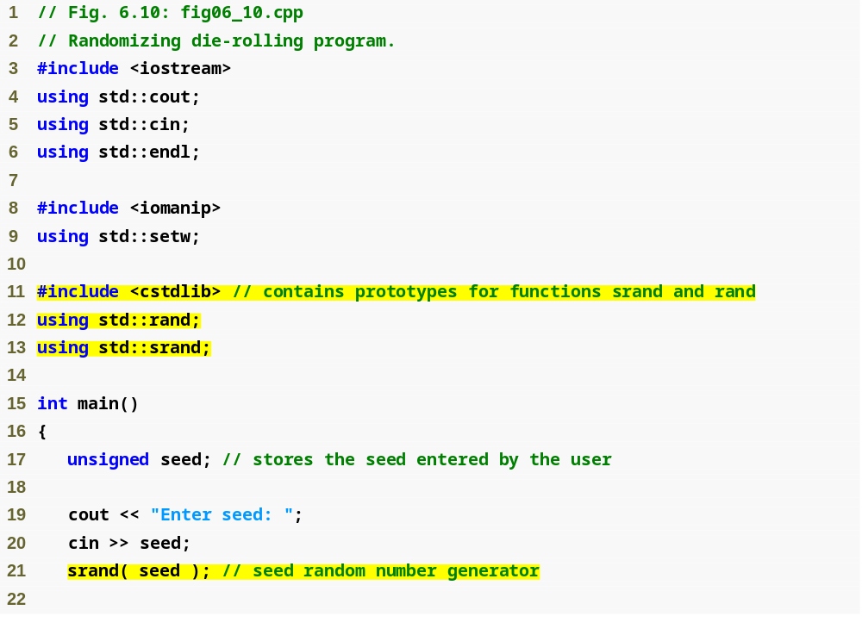
Outline
fig06_10.cpp
(1 of 2)
using statement for function srand
Data type unsigned is short for unsigned int
Passing seed to srand to randomize the program

Slide 59
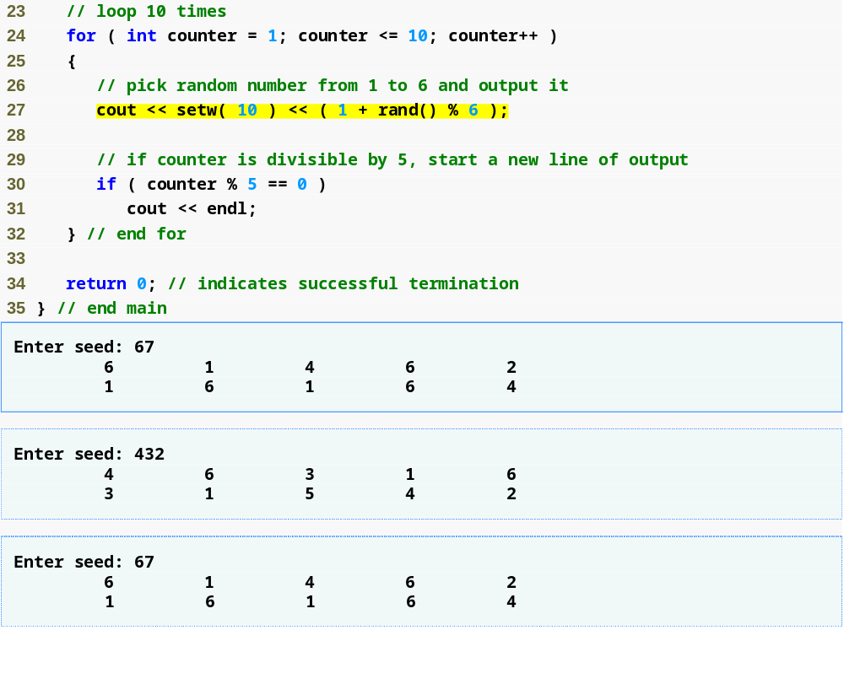
Outline
fig06_10.cpp
(2 of 2)
Program outputs show that each unique seed value produces a different sequence of random numbers

Slide 60
6.7 Case Study: Random Number Generation (Cont.)
To randomize without having to enter a seed each time
  srand( time( 0 ) );
    This causes the computer to read its clock to obtain the seed value
  Function time (with the argument 0)
    Returns the current time as the number of seconds since January 1, 1970 at midnight Greenwich Mean Time (GMT)
    Function prototype for time is in <ctime>

Slide 61
Common Programming Error 6.7
Calling function srand more than once in a program restarts the pseudorandom number sequence and can affect the randomness of the numbers produced by rand.

Slide 62
Common Programming Error 6.8
Using srand in place of rand to attempt to generate random numbers is a compilation error—function srand does not return a value.

Slide 63
6.7 Case Study: Random Number Generation (Cont.)
Scaling and shifting random numbers
  To obtain random numbers in a desired range, use a statement like
  number = shiftingValue + rand() % scalingFactor;
    shiftingValue is equal to the first number in the desired range of consecutive integers
    scalingFactor is equal to the width of the desired range of consecutive integers
      number of consecutive integers in the range

Slide 64
6.8 Case Study: Game of Chance and Introducing enum
Enumeration
  A set of integer constants represented by identifiers
    The values of enumeration constants start at 0, unless specified otherwise, and increment by 1
    The identifiers in an enum must be unique, but separate enumeration constants can have the same integer value
  Defining an enumeration
    Keyword enum
    A type name
    Comma-separated list of identifier names enclosed in braces
    Example
      enum Months { JAN = 1, FEB, MAR, APR };

Slide 65
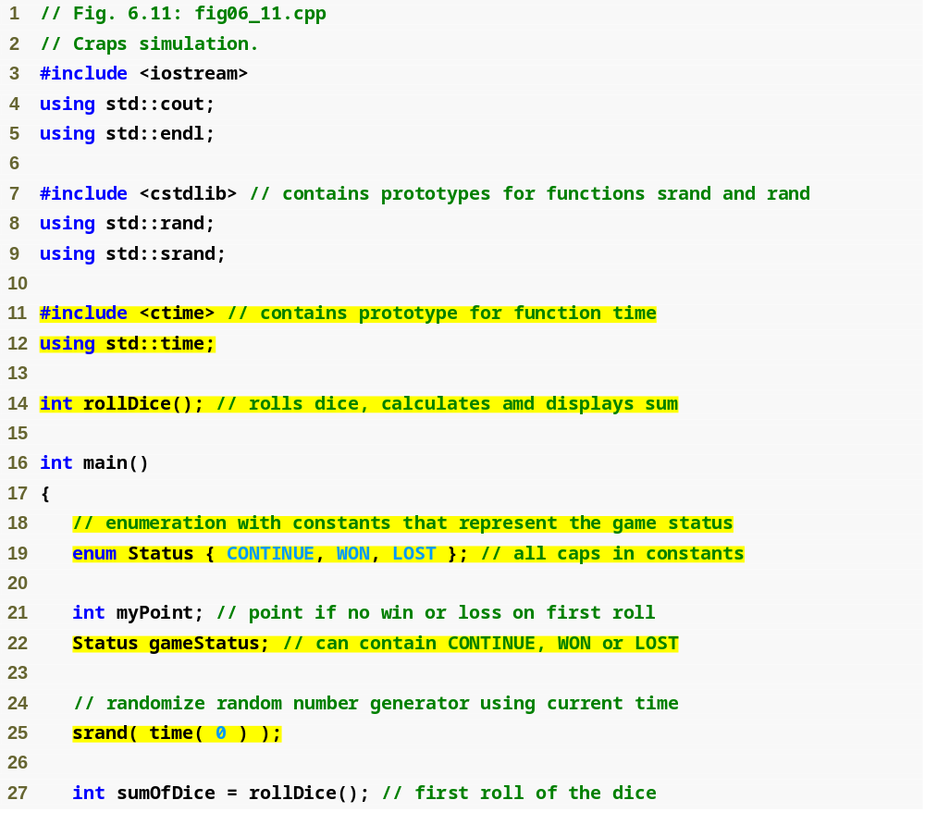
Outline
fig06_11.cpp
(1 of 4)
#include and using for function time
Enumeration to keep track of the game status
Declaring a variable of the user-defined enumeration type
Seeding the random number generator with the current time

Slide 66
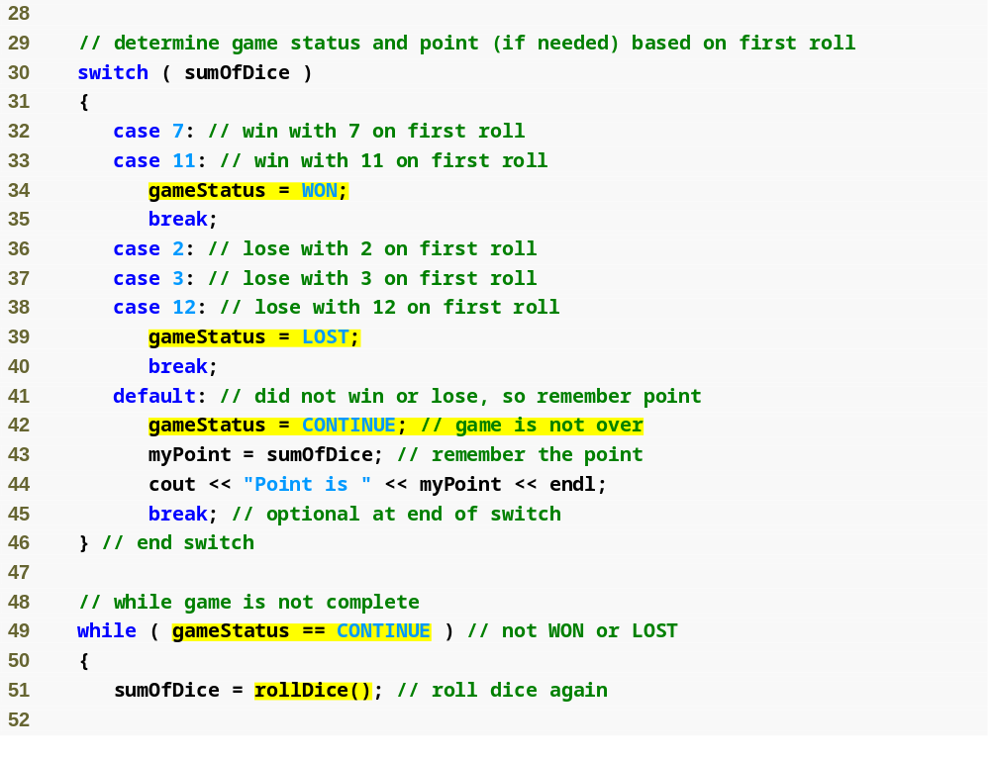
Outline
fig06_11.cpp
(2 of 4)
Assigning an enumeration constant to gameStatus
Comparing a variable of an enumeration type to an enumeration constant

Slide 67
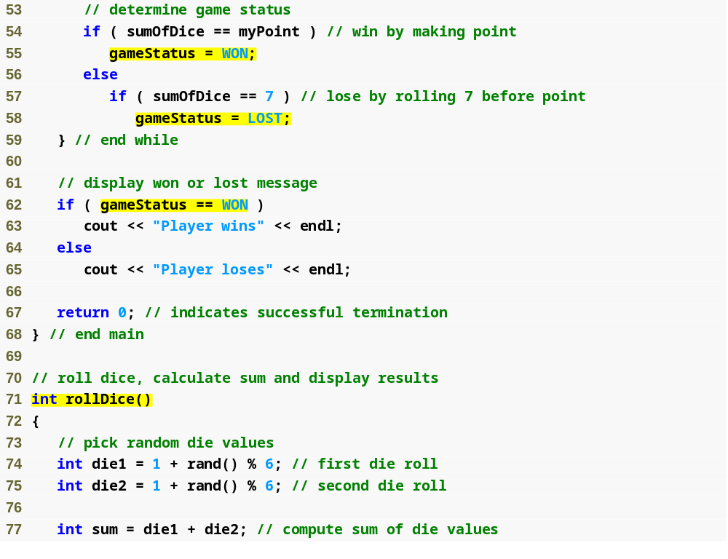
Outline
fig06_11.cpp
(3 of 4)
Function that performs the task of rolling the dice

Slide 68
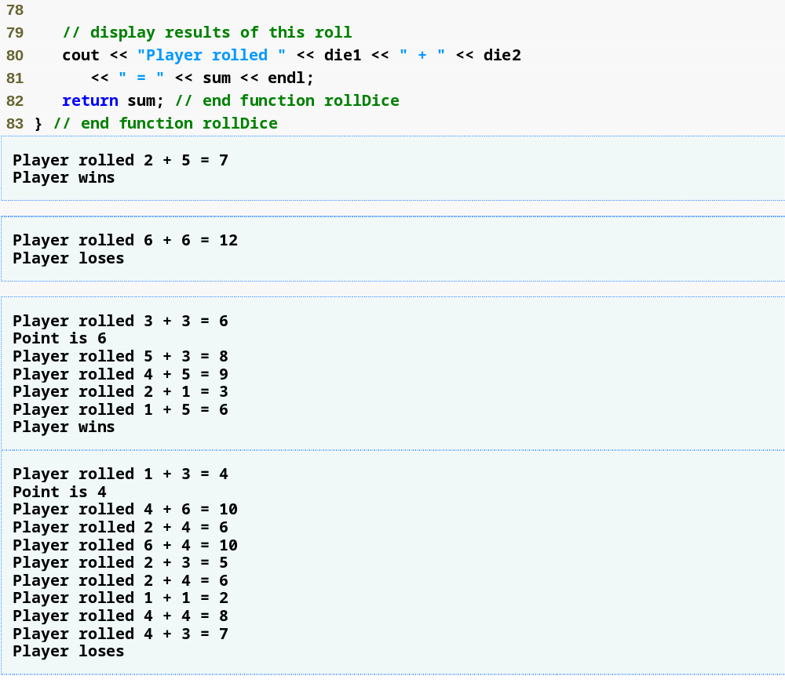
Outline
fig06_11.cpp
(4 of 4)

Slide 69
Good Programming Practice 6.1
Capitalize the first letter of an identifier used as a user-defined type name.

Slide 70
Good Programming Practice 6.2
Use only uppercase letters in the names of enumeration constants. This makes these con­stants stand out in a program and reminds the programmer that enumeration constants are not variables.

Slide 71
Good Programming Practice 6.3
Using enumerations rather than integer constants can make programs clearer and more maintainable. You can set the value of an enumeration constant once in the enumeration declaration.

Slide 72
Common Programming Error 6.9
Assigning the integer equivalent of an enumeration constant to a variable of the enumeration type is a compilation error.

Slide 73
Common Programming Error 6.10
After an enumeration constant has been defined, attempting to assign another value to the enumeration constant is a compilation error.

Slide 74
6.9 Storage Classes
Each identifier has several attributes
  Name, type, size and value
  Also storage class, scope and linkage
C++ provides five storage-class specifiers:
  auto, register, extern, mutable and static
Identifier’s storage class
  Determines the period during which that identifier exists in memory
Identifier’s scope
  Determines where the identifier can be referenced in a program

Slide 75
6.9 Storage Classes (Cont.)
Identifier’s linkage
  Determines whether an identifier is known only in the source file where it is declared or across multiple files that are compiled, then linked together
An identifier’s storage-class specifier helps determine its storage class and linkage

Slide 76
6.9 Storage Classes (Cont.)
Automatic storage class
  Declared with keywords auto and register
  Automatic variables
    Created when program execution enters block in which they are defined
    Exist while the block is active
    Destroyed when the program exits the block
  Only local variables and parameters can be of automatic storage class
    Such variables normally are of automatic storage class

Slide 77
Performance Tip 6.1
Automatic storage is a means of conserving memory, because automatic storage class variables exist in memory only when the block in which they are defined is executing.

Slide 78
Software Engineering Observation 6.8
Automatic storage is an example of the principle of least privilege, which is fundamental to good software engineering. In the context of an application, the principle states that code should be granted only the amount of privilege and access that it needs to accomplish its designated task, but no more. Why should we have variables stored in memory and accessible when they are not needed?

Slide 79
Performance Tip 6.2
The storage-class specifier register can be placed before an automatic variable declaration to suggest that the compiler maintain the variable in one of the computer’s high-speed hardware registers rather than in memory. If intensely used variables such as counters or totals are maintained in hardware registers, the overhead of repeatedly loading the variables from memory into the registers and storing the results back into memory is eliminated.

Slide 80
6.9 Storage Classes (Cont.)
Storage-class specifier auto
  Explicitly declares variables of automatic storage class
  Local variables are of automatic storage class by default
    So keyword auto rarely is used
Storage-class specifier register
  Data in the machine-language version of a program is normally loaded into registers for calculations and other processing
    Compiler tries to store register storage class variables in a register
  The compiler might ignore register declarations
    May not be sufficient registers for the compiler to use

Slide 81
Common Programming Error 6.11
Using multiple storage-class specifiers for an identifier is a syntax error. Only one storage class specifier can be applied to an identifier. For example, if you include register, do not also include auto.

Slide 82
Performance Tip 6.3
Often, register is unnecessary. Today’s optimizing compilers are capable of recognizing frequently used variables and can decide to place them in registers without needing a register declaration from the programmer.

Slide 83
6.9 Storage Classes (Cont.)
Static storage class
  Declared with keywords extern and static
  Static-storage-class variables
    Exist from the point at which the program begins execution
    Initialized once when their declarations are encountered
    Last for the duration of the program
  Static-storage-class functions
    The name of the function exists when the program begins execution, just as for all other functions
  However, even though the variables and the function names exist from the start of program execution, this does not mean that these identifiers can be used throughout the program.

Slide 84
6.9 Storage Classes (Cont.)
Two types of identifiers with static storage class
  External identifiers
    Such as global variables and global function names
  Local variables declared with the storage class specifier static
Global variables
  Created by placing variable declarations outside any class or function definition
  Retain their values throughout the execution of the program
  Can be referenced by any function that follows their declarations or definitions in the source file

Slide 85
Software Engineering Observation 6.9
Declaring a variable as global rather than local allows unintended side effects to occur when a function that does not need access to the variable accidentally or maliciously modifies it. This is another example of the principle of least privilege. In general, except for truly global resources such as cin and cout, the use of global variables should be avoided except in certain situations with unique performance requirements.

Slide 86
Software Engineering Observation 6.10
Variables used only in a particular function should be declared as local variables in that function rather than as global variables.

Slide 87
6.9 Storage Classes (Cont.)
Local variables declared with keyword static
  Known only in the function in which they are declared
  Retain their values when the function returns to its caller
    Next time the function is called, the static local variables contain the values they had when the function last completed
  If numeric variables of the static storage class are not explicitly initialized by the programmer
    They are initialized to zero

Slide 88
6.10 Scope Rules
Scope
  Portion of the program where an identifier can be used
  Four scopes for an identifier
    Function scope
    File scope
    Block scope
    Function-prototype scope

Slide 89
6.10 Scope Rules (Cont.)
File scope
  For an identifier declared outside any function or class
    Such an identifier is “known” in all functions from the point at which it is declared until the end of the file
  Global variables, function definitions and function prototypes placed outside a function all have file scope
Function scope
  Labels (identifiers followed by a colon such as start:) are the only identifiers with function scope
    Can be used anywhere in the function in which they appear
    Cannot be referenced outside the function body
    Labels are implementation details that functions hide from one another

Slide 90
6.10 Scope Rules (Cont.)
Block scope
  Identifiers declared inside a block have block scope
    Block scope begins at the identifier’s declaration
    Block scope ends at the terminating right brace (}) of the block in which the identifier is declared
  Local variables and function parameters have block scope
    The function body is their block
  Any block can contain variable declarations
  Identifiers in an outer block can be “hidden” when a nested block has a local identifier with the same name
  Local variables declared static still have block scope, even though they exist from the time the program begins execution
    Storage duration does not affect the scope of an identifier

Slide 91
6.10 Scope Rules (Cont.)
Function-prototype scope
  Only identifiers used in the parameter list of a function prototype have function-prototype scope
  Parameter names appearing in a function prototype are ignored by the compiler
    Identifiers used in a function prototype can be reused elsewhere in the program without ambiguity
    However, in a single prototype, a particular identifier can be used only once

Slide 92
Common Programming Error 6.12
Accidentally using the same name for an identifier in an inner block that is used for an identifier in an outer block, when in fact the programmer wants the identifier in the outer block to be active for the duration of the inner block, is normally a logic error.

Slide 93
Good Programming Practice 6.4
Avoid variable names that hide names in outer scopes. This can be accomplished by avoiding the use of duplicate identifiers in a program.

Slide 94
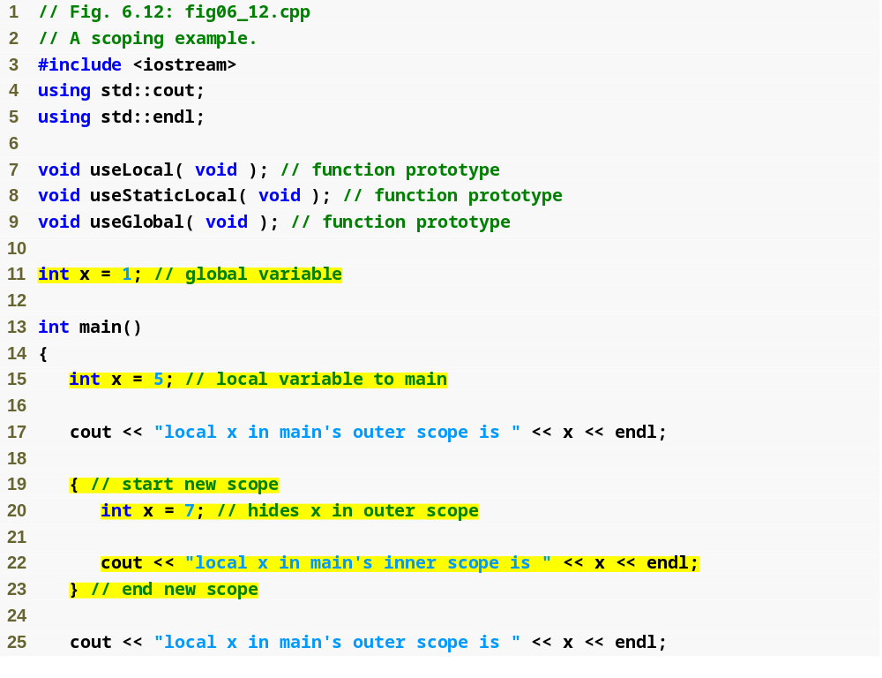
Outline
fig06_12.cpp
(1 of 4)
Declaring a global variable outside any class or function definition
Local variable x that hides global variable x
Local variable x in a block that hides local variable x in outer scope

Slide 95
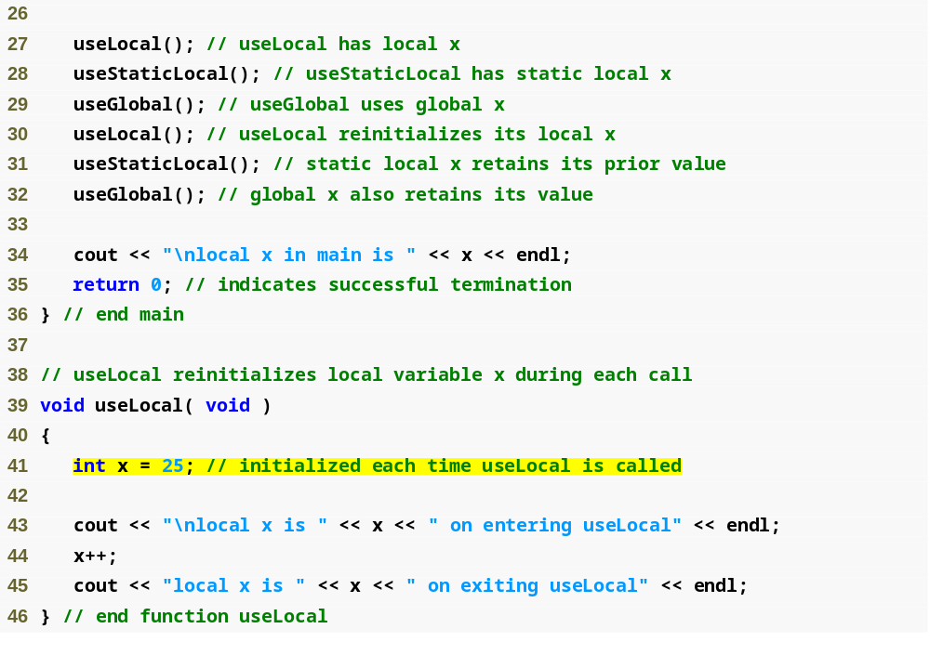
Outline
fig06_12.cpp
(2 of 4)
Local variable that gets recreated and reinitialized each time useLocal is called

Slide 96
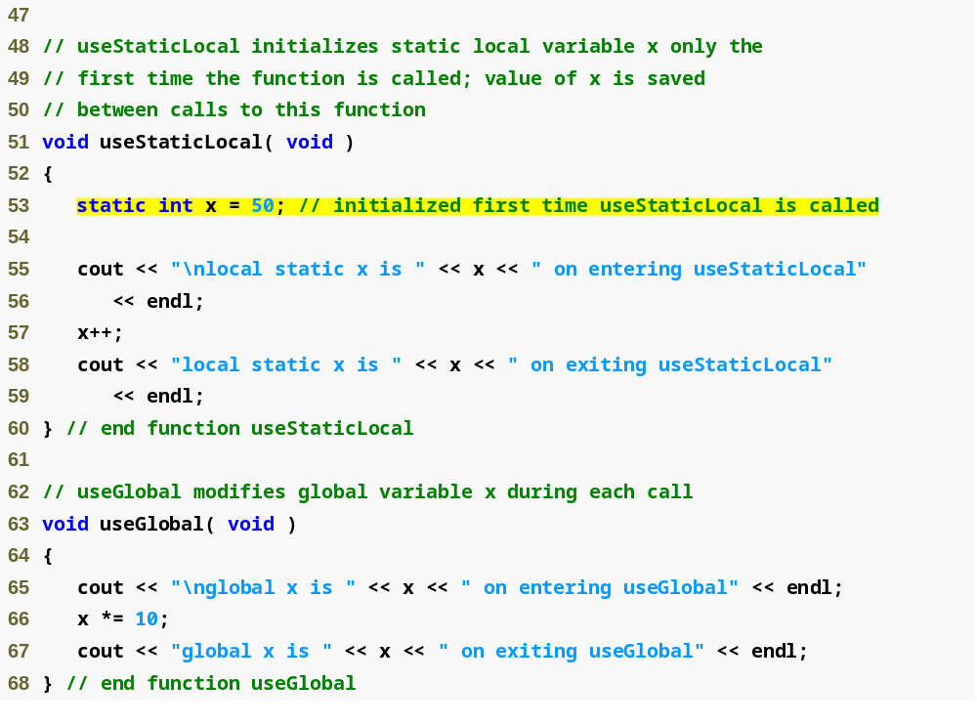
Outline
static local variable that gets initialized only once
fig06_12.cpp
(3 of 4)
Statement refers to global variable x because no local variable named x exists

Slide 97
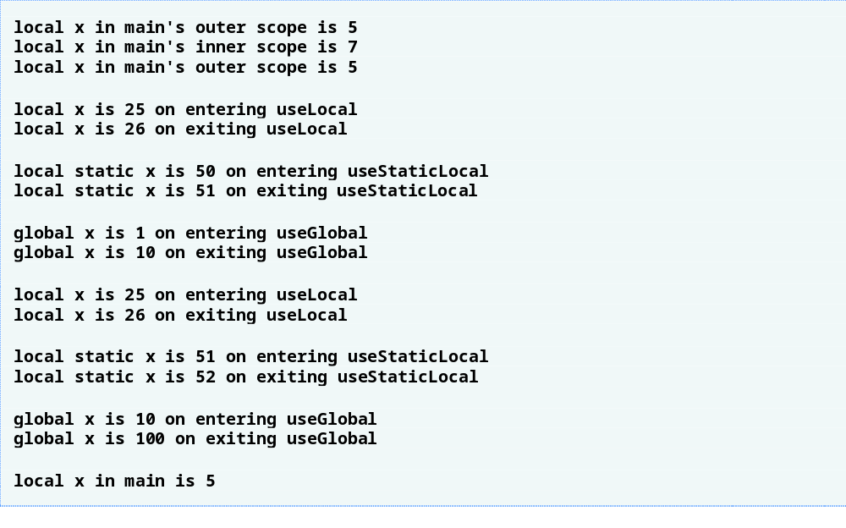
Outline
fig06_12.cpp
(4 of 4)

Slide 98
6.11 Function Call Stack and Activation Records
Data structure: collection of related data items
Stack data structure
  Analogous to a pile of dishes
  When a dish is placed on the pile, it is normally placed at the top
    Referred to as pushing the dish onto the stack
  Similarly, when a dish is removed from the pile, it is normally removed from the top
    Referred to as popping the dish off the stack
  A last-in, first-out (LIFO) data structure
    The last item pushed (inserted) on the stack is the first item popped (removed) from the stack

Slide 99
6.11 Function Call Stack and Activation Records (Cont.)
Function Call Stack
  Sometimes called the program execution stack
  Supports the function call/return mechanism
    Each time a function calls another function, a stack frame (also known as an activation record) is pushed onto the stack
      Maintains the return address that the called function needs to return to the calling function
      Contains automatic variables—parameters and any local variables the function declares

Slide 100
6.11 Function Call Stack and Activation Records (Cont.)
Function Call Stack (Cont.)
  When the called function returns
    Stack frame for the function call is popped
    Control transfers to the return address in the popped stack frame
  If a function makes a call to another function
    Stack frame for the new function call is simply pushed onto the call stack
    Return address required by the newly called function to return to its caller is now located at the top of the stack.
Stack overflow
  Error that occurs when more function calls occur than can have their activation records stored on the function call stack (due to memory limitations)

Slide 101
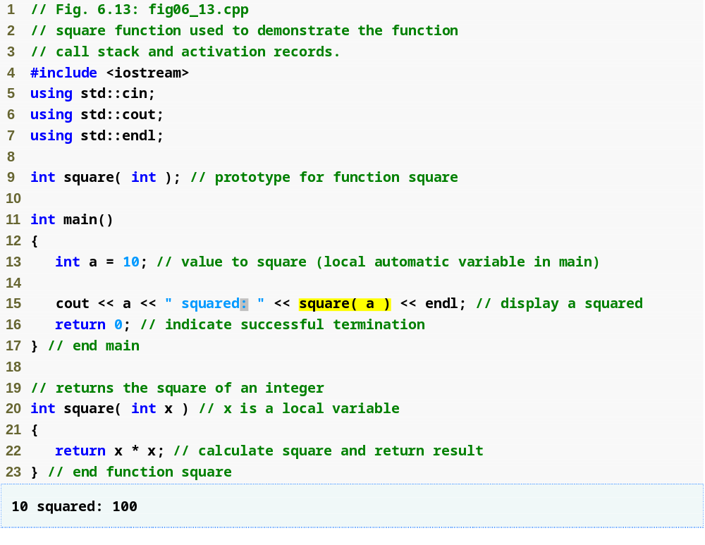
Outline
fig06_13.cpp
(1 of 1)
Calling function square

Slide 102
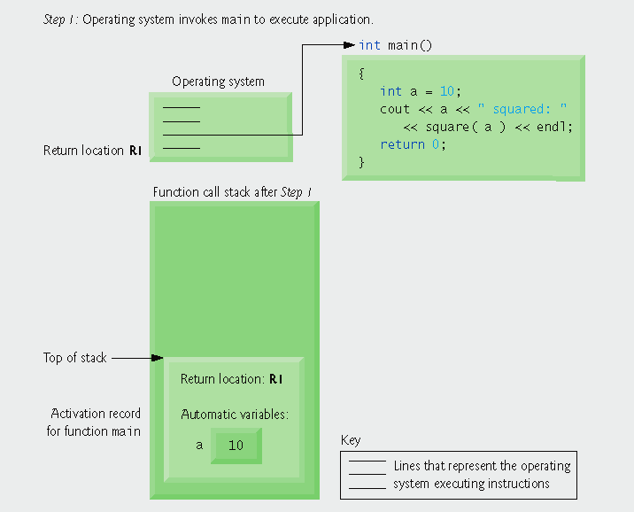
Fig. 6.14 | Function call stack after the operating system invokes main to execute the application.
Operating system calls main, pushing an activation record onto the stack

Slide 103
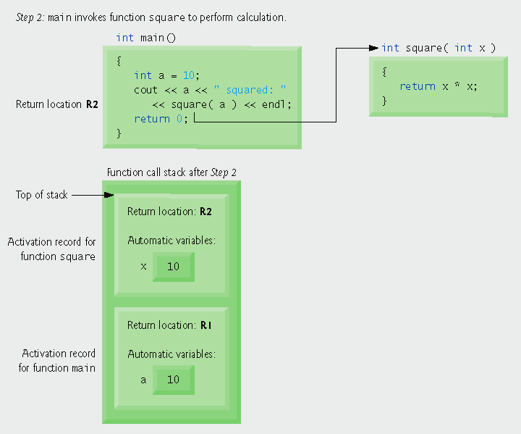
Fig. 6.15 | Function call stack after main invokes function square to perform the calculation.
main calls function square, pushing another stack frame onto the function call stack

Slide 104
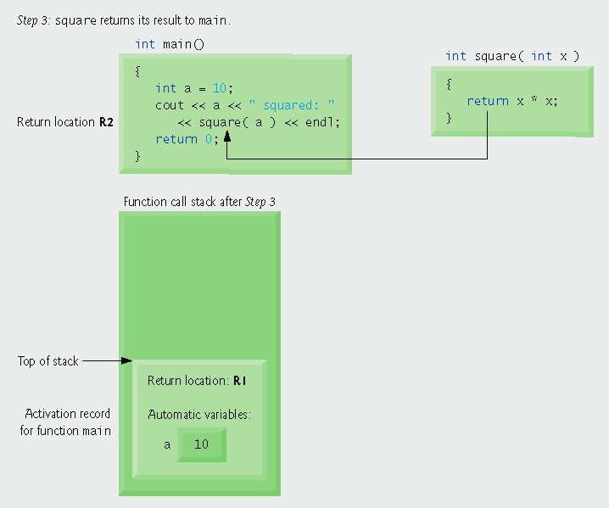
Fig. 6.16 | Function call stack after function square returns to main.
Program control returns to main and square’s stack frame is popped off

Slide 105
6.12 Functions with Empty Parameter Lists
Empty parameter list
  Specified by writing either void or nothing at all in parentheses
  For example,
  void print();
  specifies that function print does not take arguments and does not return a value

Slide 106
Portability Tip 6.2
The meaning of an empty function parameter list in C++ is dramatically different than in C. In C, it means all argument checking is disabled (i.e., the function call can pass any arguments it wants). In C++, it means that the function explicitly takes no arguments. Thus, C programs using this feature might cause compilation errors when compiled in C++.

Slide 107
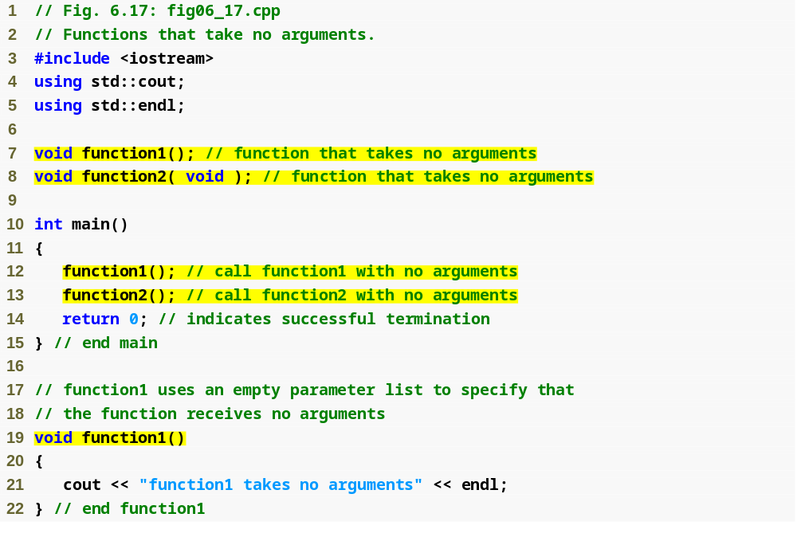
Outline
Specify an empty parameter list by putting nothing in the parentheses
fig06_17.cpp
(1 of 2)
Specify an empty parameter list by putting void in the parentheses

Slide 108
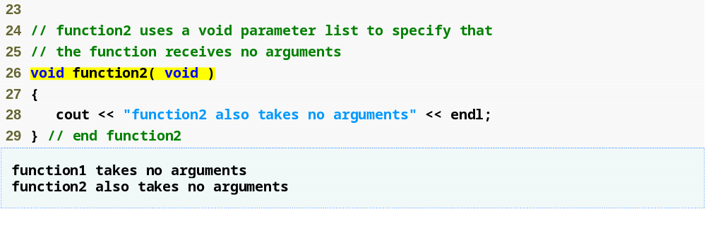
Outline
fig06_17.cpp
(2 of 2)

Slide 109
Common Programming Error 6.13
C++ programs do not compile unless function prototypes are provided for every function or each function is defined before it is called.

Slide 110
6.13 Inline Functions
Inline functions
  Reduce function call overhead—especially for small functions
  Qualifier inline before a function’s return type in the function definition
    “Advises” the compiler to generate a copy of the function’s code in place (when appropriate) to avoid a function call
  Trade-off of inline functions
    Multiple copies of the function code are inserted in the program (often making the program larger)
  The compiler can ignore the inline qualifier and typically does so for all but the smallest functions

Slide 111
Software Engineering Observation 6.11
Any change to an inline function could require all clients of the function to be recompiled. This can be significant in some program development and maintenance situations.

Slide 112
Good Programming Practice 6.5
The inline qualifier should be used only with small, frequently used functions.

Slide 113
Performance Tip 6.4
Using inline functions can reduce execution time but may increase program size.

Slide 114
Software Engineering Observation 6.12
The const qualifier should be used to enforce the principle of least privilege. Using the principle of least privilege to properly design software can greatly reduce debugging time and improper side effects and can make a program easier to modify and maintain.

Slide 115
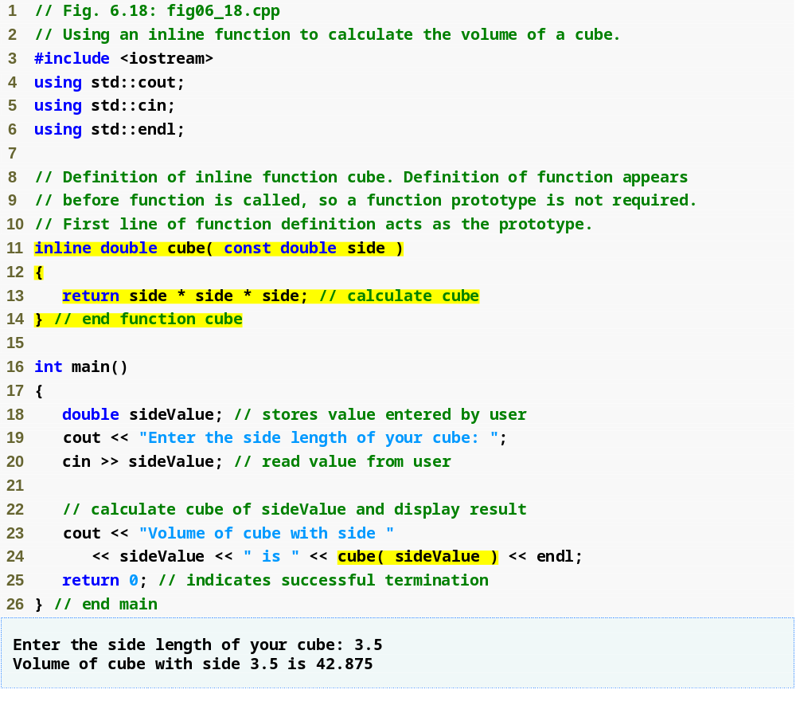
Outline
fig06_18.cpp
(1 of 1)
Complete function definition so the compiler knows how to expand a cube function call into its inlined code.
inline qualifier
cube function call that could be inlined

Slide 116
6.14 References and Reference Parameters
Two ways to pass arguments to functions
  Pass-by-value
    A copy of the argument’s value is passed to the called function
    Changes to the copy do not affect the original variable’s value in the caller
      Prevents accidental side effects of functions
  Pass-by-reference
    Gives called function the ability to access and modify the caller’s argument data directly

Slide 117
Performance Tip 6.5
One disadvantage of pass-by-value is that, if a large data item is being passed, copying that data can take a considerable amount of execution time and memory space.

Slide 118
6.14 References and Reference Parameters (Cont.)
Reference Parameter
  An alias for its corresponding argument in a function call
  & placed after the parameter type in the function prototype and function header
  Example
    int &count in a function header
      Pronounced as “count is a reference to an int”
  Parameter name in the body of the called function actually refers to the original variable in the calling function

Slide 119
Performance Tip 6.6
Pass-by-reference is good for performance reasons, because it can eliminate the pass-by-value overhead of copying large amounts of data.

Slide 120
Software Engineering Observation 6.13
Pass-by-reference can weaken security, because the called function can corrupt the caller’s data.

Slide 121
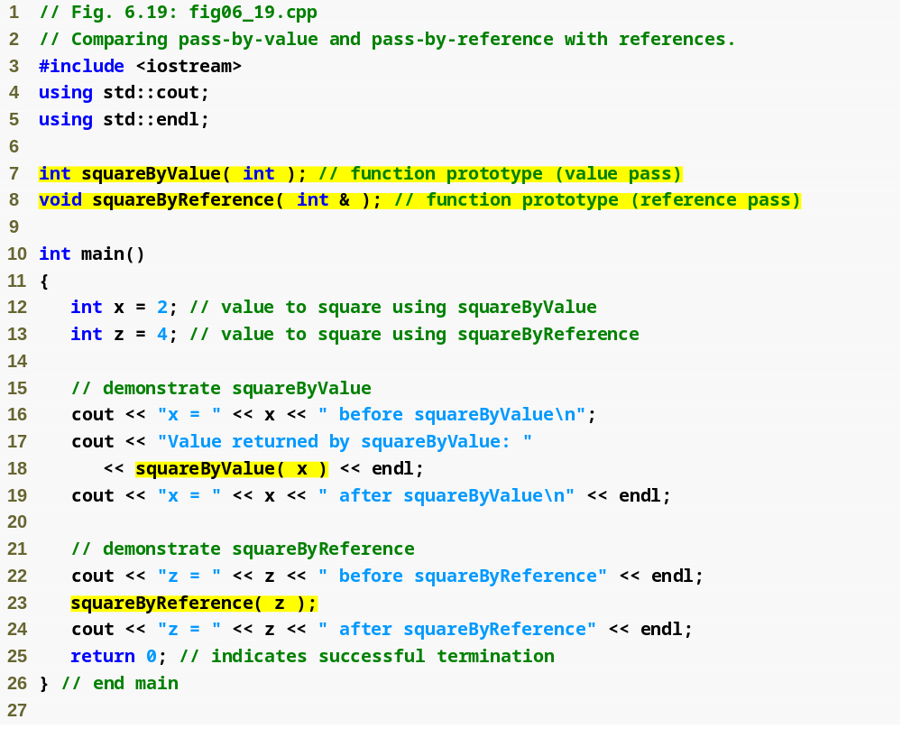
Outline
Function illustrating pass-by-value
fig06_19.cpp
(1 of 2)
Function illustrating pass-by-reference
Variable is simply mentioned by name in both function calls

Slide 122
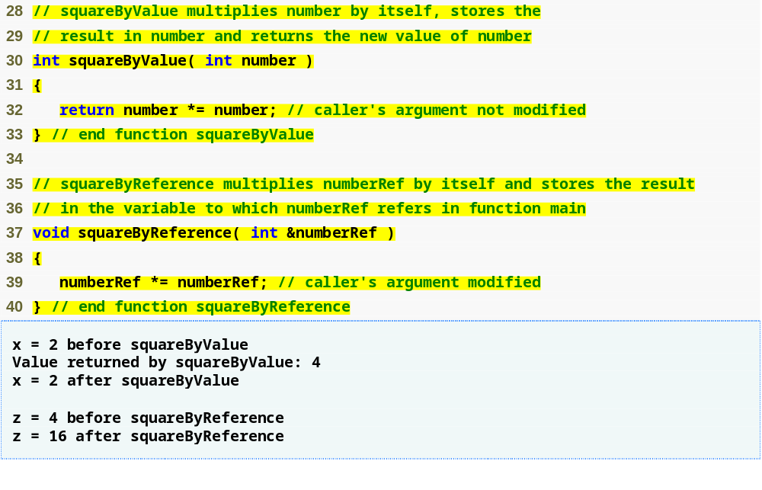
Outline
Receives copy of argument in main
fig06_19.cpp
(2 of 2)
Receives reference to argument in main
Modifies variable in main

Slide 123
Common Programming Error 6.14
Because reference parameters are mentioned only by name in the body of the called function, the programmer might inadvertently treat reference parameters as pass-by-value parameters. This can cause unexpected side effects if the original copies of the variables are changed by the function.

Slide 124
Performance Tip 6.7
For passing large objects, use a constant reference parameter to simulate the appearance and security of pass-by-value and avoid the overhead of passing a copy of the large object.

Slide 125
Software Engineering Observation 6.14
Many programmers do not bother to declare parameters passed by value as const, even though the called function should not be modifying the passed argument. Keyword const in this context would protect only a copy of the original argument, not the original argument itself, which when passed by value is safe from modification by the called function.

Slide 126
Software Engineering Observation 6.15
For the combined reasons of clarity and performance, many C++ programmers prefer that modifiable arguments be passed to functions by using pointers (which we study in Chapter 8), small nonmodifiable arguments be passed by value and large nonmodifiable arguments be passed to functions by using references to constants.

Slide 127
6.14 References and Reference Parameters (Cont.)
References
  Can also be used as aliases for other variables within a function
    All operations supposedly performed on the alias (i.e., the reference) are actually performed on the original variable
    An alias is simply another name for the original variable
    Must be initialized in their declarations
      Cannot be reassigned afterward
  Example
    int count = 1;
    int &cRef = count;
    cRef++;
      Increments count through alias cRef

Slide 128
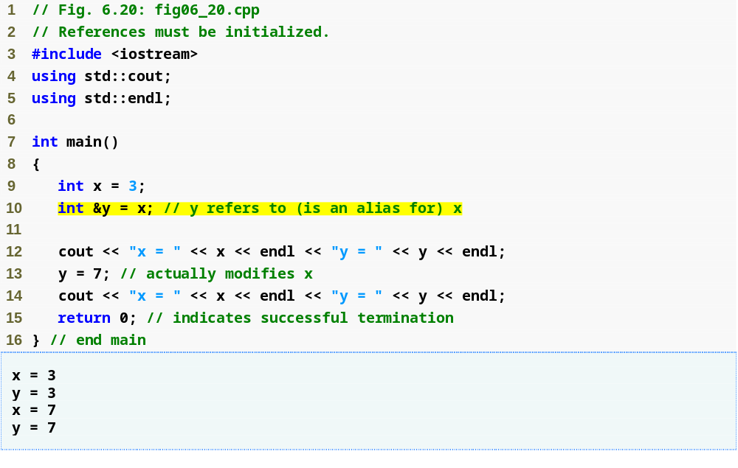
Outline
Creating a reference as an alias to another variable in the function
fig06_20.cpp
(1 of 1)
Assign 7 to x through alias y

Slide 129
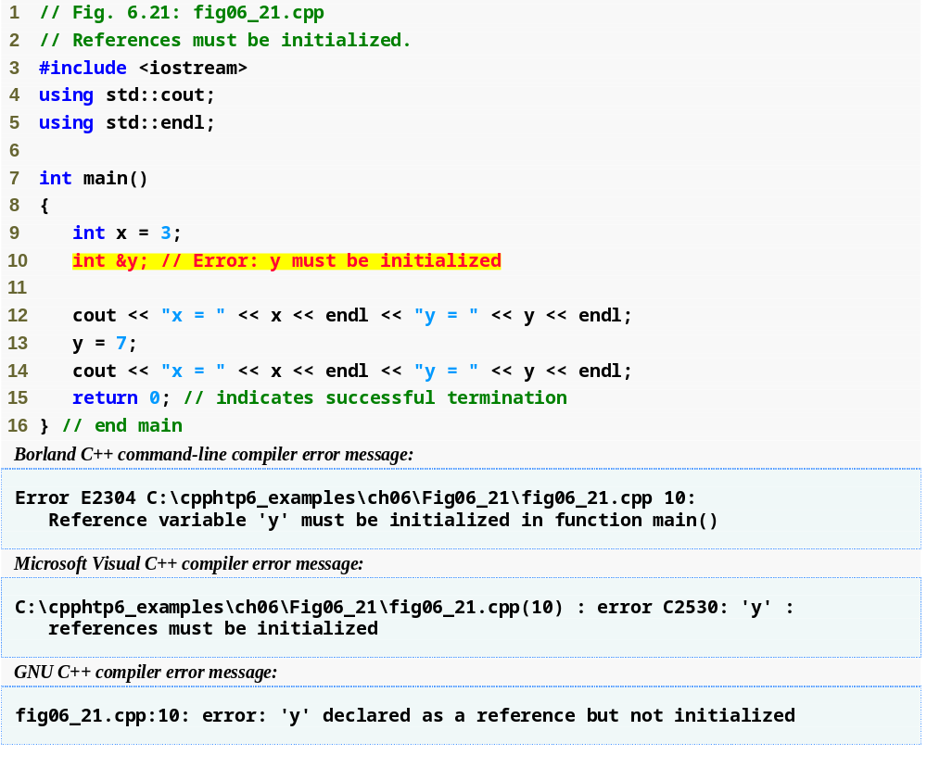
Outline
fig06_21.cpp
(1 of 2)
Uninitialized reference

Slide 130
6.14 References and Reference Parameters (Cont.)
Returning a reference from a function
  Functions can return references to variables
    Should only be used when the variable is static
  Dangling reference
    Returning a reference to an automatic variable
      That variable no longer exists after the function ends

Slide 131
Common Programming Error 6.15
Not initializing a reference variable when it is declared is a compilation error, unless the declaration is part of a function’s parameter list. Reference parameters are initialized when the function in which they are declared is called.

Slide 132
Common Programming Error 6.16
Attempting to reassign a previously declared reference to be an alias to another variable is a logic error. The value of the other variable is simply assigned to the variable for which the reference is already an alias.

Slide 133
Common Programming Error 6.17
Returning a reference to an automatic variable in a called function is a logic error. Some compilers issue a warning when this occurs.

Slide 134
6.15 Default Arguments
Default argument
  A default value to be passed to a parameter
    Used when the function call does not specify an argument for that parameter
  Must be the rightmost argument(s) in a function’s parameter list
  Should be specified with the first occurrence of the function name
    Typically the function prototype

Slide 135
Common Programming Error 6.18
It is a compilation error to specify default arguments in both a function’s prototype and header.

Slide 136
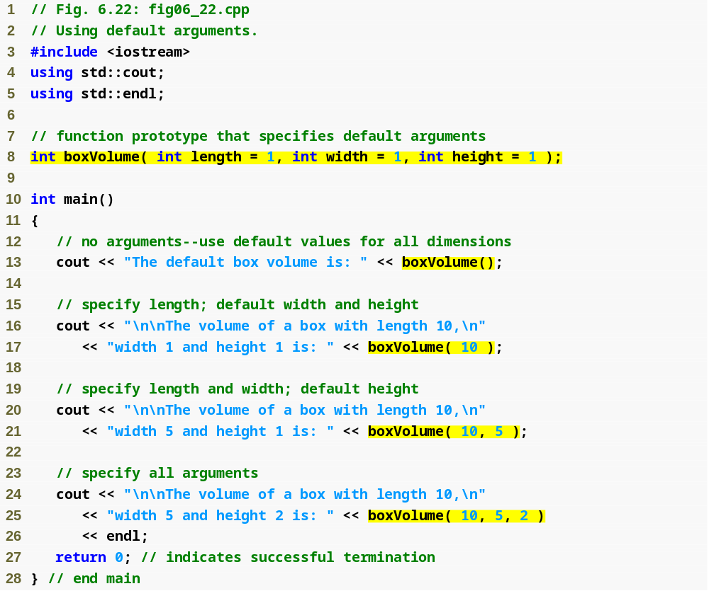
Outline
fig06_22.cpp
(1 of 2)
Default arguments
Calling function with no arguments; uses three defaults
Calling function with one argument; uses two defaults
Calling function with two arguments; uses one default
Calling function with three arguments; uses no defaults

Slide 137
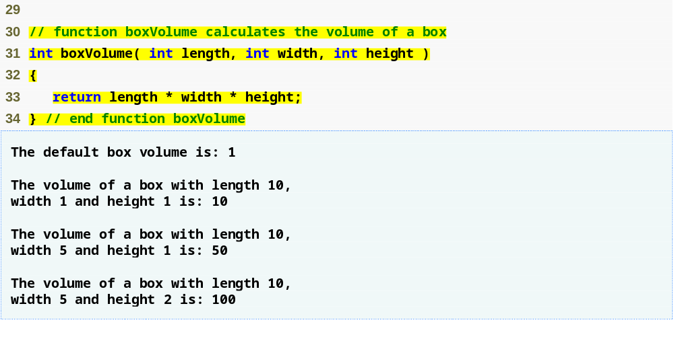
Outline
fig06_22.cpp
(2 of 2)
Note that default arguments were specified in the function prototype, so they are not specified in the function header

Slide 138
Good Programming Practice 6.6
Using default arguments can simplify writing function calls. However, some programmers feel that explicitly specifying all arguments is clearer.

Slide 139
Software Engineering Observation 6.16
If the default values for a function change, all client code using the function must be recompiled.

Slide 140
Common Programming Error 6.19
Specifying and attempting to use a default argument that is not a rightmost (trailing) argument (while not simultaneously defaulting all the rightmost arguments) is a syntax error.

Slide 141
6.16 Unary Scope Resolution Operator
Unary scope resolution operator (::)
  Used to access a global variable when a local variable of the same name is in scope
  Cannot be used to access a local variable of the same name in an outer block

Slide 142
Common Programming Error 6.20
It is an error to attempt to use the unary scope resolution operator (::) to access a nonglobal variable in an outer block. If no global variable with that name exists, a compilation error occurs. If a global variable with that name exists, this is a logic error, because the program will refer to the global variable when you intended to access the nonglobal variable in the outer block.

Slide 143
Good Programming Practice 6.7
Always using the unary scope resolution operator (::) to refer to global variables makes programs easier to read and understand, because it makes it clear that you are intending to access a global variable rather than a nonglobal variable.

Slide 144
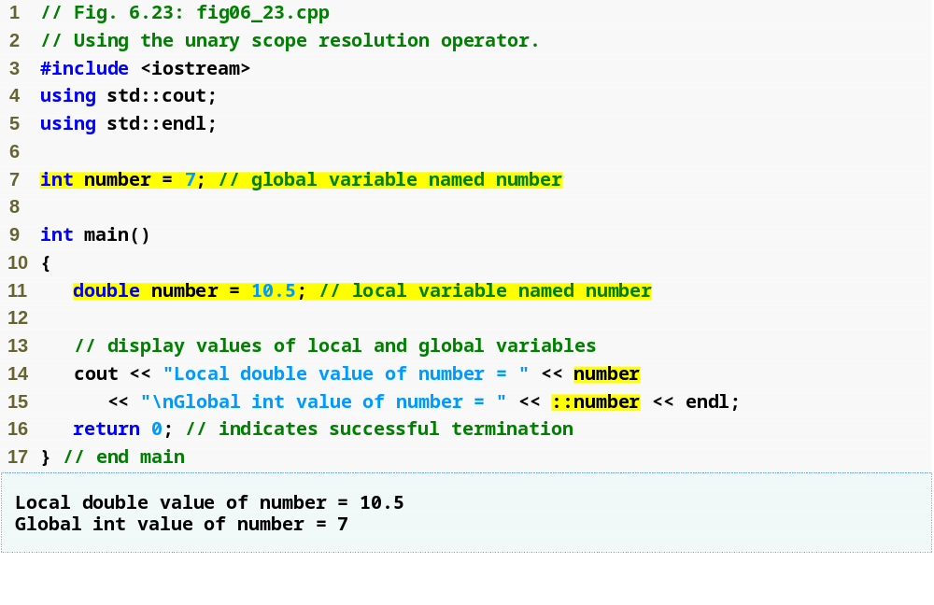
Outline
fig06_23.cpp
(1 of 1)
Unary scope resolution operator used to access global variable number

Slide 145
Software Engineering Observation 6.17
Always using the unary scope resolution operator (::) to refer to global variables makes programs easier to modify by reducing the risk of name collisions with nonglobal variables.

Slide 146
Error-Prevention Tip 6.4
Always using the unary scope resolution operator (::) to refer to a global variable eliminates possible logic errors that might occur if a nonglobal variable hides the global variable.

Slide 147
Error-Prevention Tip 6.5
Avoid using variables of the same name for different purposes in a program. Although this is allowed in various circumstances, it can lead to errors.

Slide 148
6.17 Function Overloading
Overloaded functions
  Overloaded functions have
    Same name
    Different sets of parameters
  Compiler selects proper function to execute based on number, types and order of arguments in the function call
  Commonly used to create several functions of the same name that perform similar tasks, but on different data types

Slide 149
Good Programming Practice 6.8
Overloading functions that perform closely related tasks can make programs more readable and understandable.

Slide 150
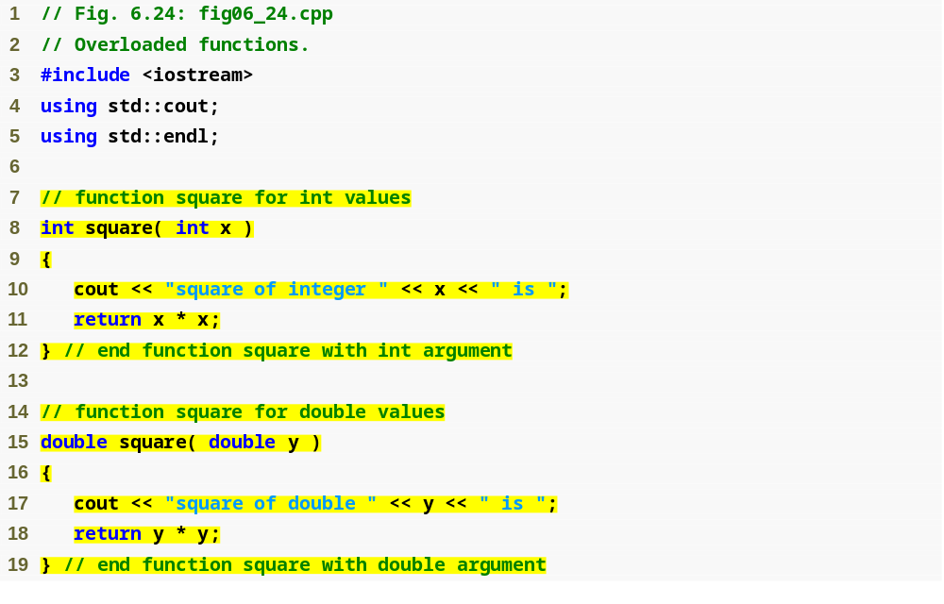
Outline
fig06_24.cpp
(1 of 2)
Defining a square function for ints
Defining a square function for doubles

Slide 151
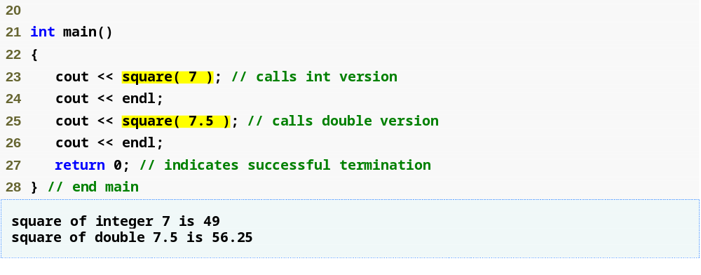
Outline
fig06_24.cpp
(2 of 2)
Output confirms that the proper function was called in each case

Slide 152
6.17 Function Overloading (Cont.)
How the compiler differentiates overloaded functions
  Overloaded functions are distinguished by their signatures
  Name mangling or name decoration
    Compiler encodes each function identifier with the number and types of its parameters to enable type-safe linkage
  Type-safe linkage ensures that
    Proper overloaded function is called
    Types of the arguments conform to types of the parameters

Slide 153
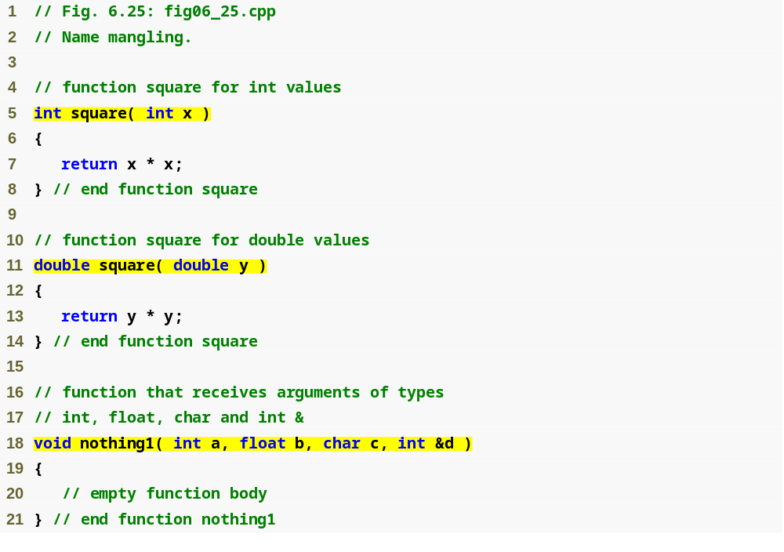
Outline
fig06_25.cpp
(1 of 2)
Overloaded square functions

Slide 154
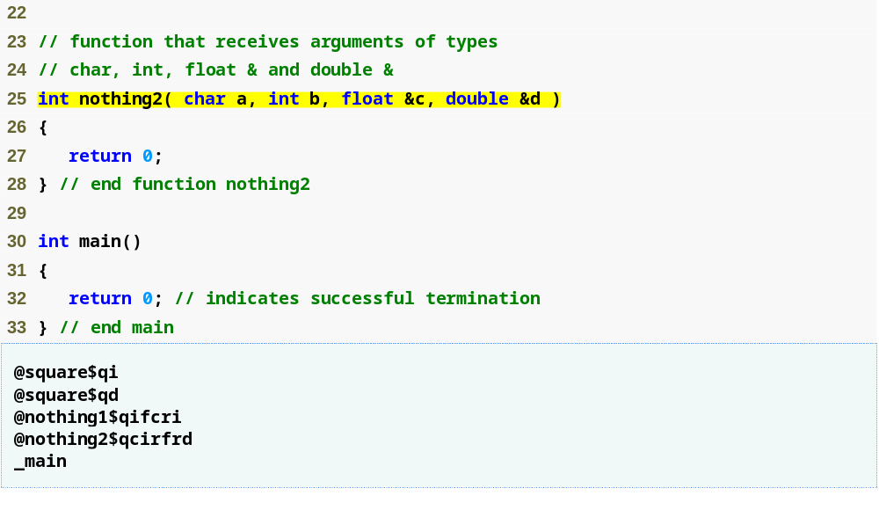
Outline
fig06_25.cpp
(2 of 2)
Mangled names of overloaded functions
main is not mangled because it cannot be overloaded

Slide 155
Common Programming Error 6.21
Creating overloaded functions with identical parameter lists and different return types is a compilation error.

Slide 156
Common Programming Error 6.22
A function with default arguments omitted might be called identically to another overloaded function; this is a compilation error. For example, having in a program both a function that explicitly takes no arguments and a function of the same name that contains all default arguments results in a compilation error when an attempt is made to use that function name in a call passing no arguments. The compiler does not know which version of the function to choose.

Slide 157
6.18 Function Templates
Function templates
  More compact and convenient form of overloading
    Identical program logic and operations for each data type
  Function template definition
    Written by programmer once
    Essentially defines a whole family of overloaded functions
    Begins with the template keyword
    Contains template parameter list of formal type parameters for the function template enclosed in angle brackets (<>)
    Formal type parameters
      Preceded by keyword typename or keyword class
      Placeholders for fundamental types or user-defined types

Slide 158
6.18 Function Templates (Cont.)
Function-template specializations
  Generated automatically by the compiler to handle each type of call to the function template
  Example for function template max with type parameter T called with int arguments
    Compiler detects a max invocation in the program code
    int is substituted for T throughout the template definition
    This produces function-template specialization max< int >

Slide 159
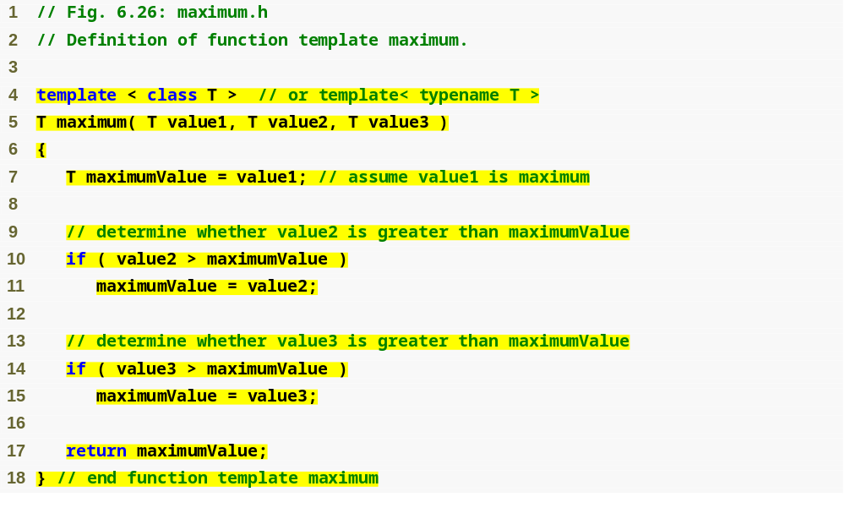
Outline
Using formal type parameter T in place of data type
fig06_26.cpp
(1 of 1)

Slide 160
Common Programming Error 6.23
Not placing keyword class or keyword typename before every formal type parameter of a function template (e.g., writing < class S, T > instead of < class S, class T >) is a syntax error.

Slide 161
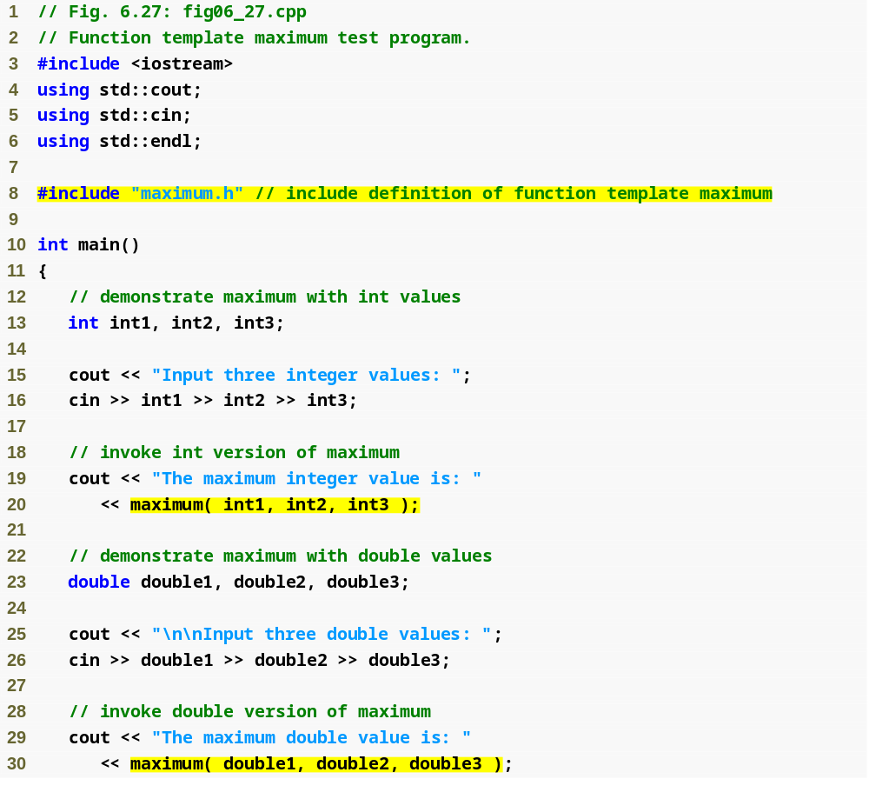
Outline
fig06_27.cpp
(1 of 2)
Invoking maximum with int arguments
Invoking maximum with double arguments

Slide 162
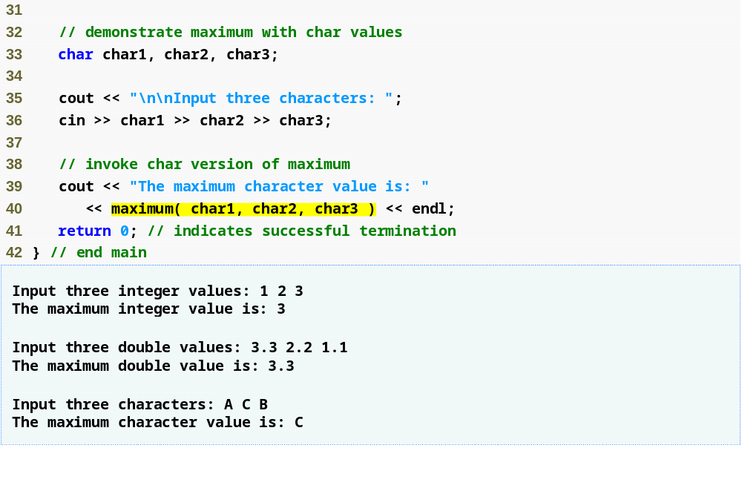
Outline
fig06_27.cpp
(2 of 2)
Invoking maximum with char arguments

Slide 163
6.19 Recursion
Recursive function
  A function that calls itself, either directly, or indirectly (through another function)
Recursion
  Base case(s)
    The simplest case(s), which the function knows how to handle
  For all other cases, the function typically divides the problem into two conceptual pieces
    A piece that the function knows how to do
    A piece that it does not know how to do
      Slightly simpler or smaller version of the original problem

Slide 164
6.19 Recursion (Cont.)
Recursion (Cont.)
  Recursive call (also called the recursion step)
    The function launches (calls) a fresh copy of itself to work on the smaller problem
    Can result in many more recursive calls, as the function keeps dividing each new problem into two conceptual pieces
    This sequence of smaller and smaller problems must eventually converge on the base case
      Otherwise the recursion will continue forever

Slide 165
6.19 Recursion (Cont.)
Factorial
  The factorial of a nonnegative integer n, written n! (and pronounced “n factorial”), is the product
    n · (n – 1) · (n – 2) · … · 1
  Recursive definition of the factorial function
    n! = n · (n – 1)!
    Example
      5! = 5 · 4 · 3 · 2 · 1
      5! = 5 · ( 4 · 3 · 2 · 1)
      5! = 5 · ( 4! )

Slide 166
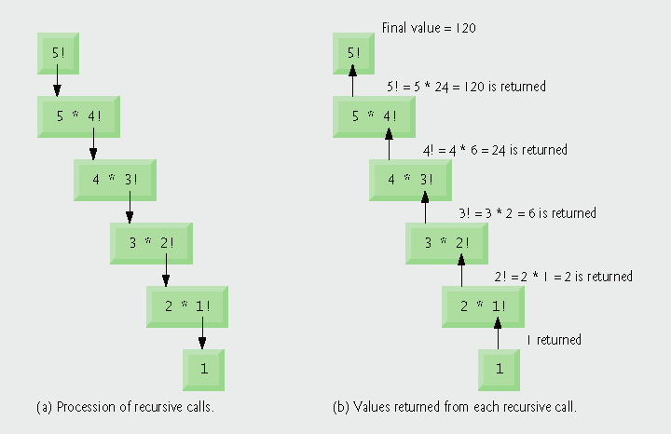
Fig. 6.28 | Recursive evaluation of 5!.

Slide 167
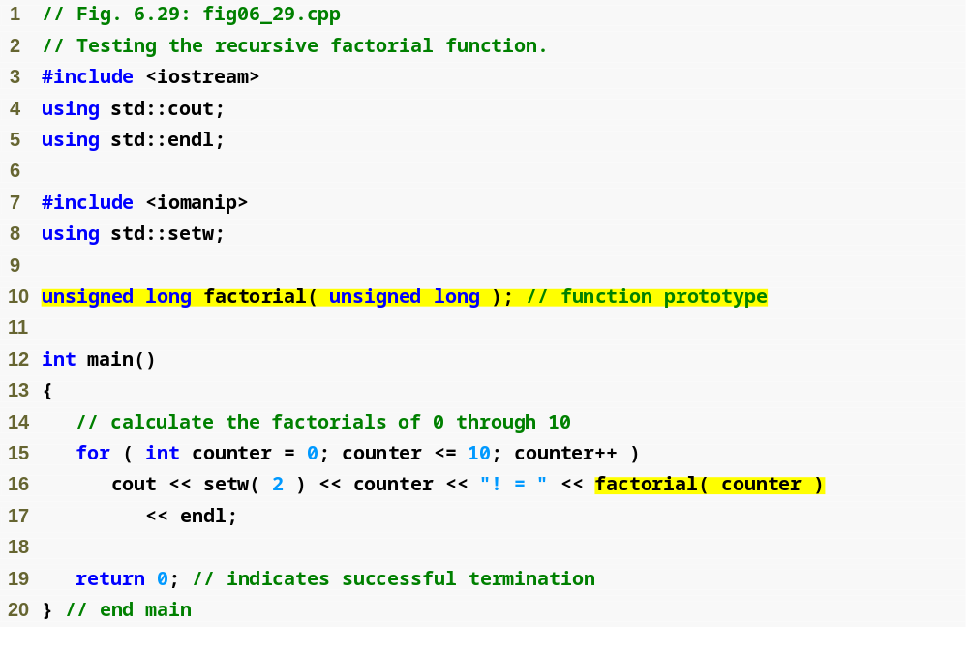
Outline
fig06_29.cpp
(1 of 2)
First call to factorial function

Slide 168

Outline
Base cases simply return 1
fig06_29.cpp
(2 of 2)
Recursive call to factorial function with a slightly smaller problem

Slide 169
Common Programming Error 6.24
Either omitting the base case, or writing the recursion step incorrectly so that it does not converge on the base case, causes “infinite” recursion, eventually exhausting memory. This is analogous to the problem of an infinite loop in an iterative (nonrecursive) solution.

Slide 170
6.20 Example Using Recursion: Fibonacci Series
The Fibonacci series
  0, 1, 1, 2, 3, 5, 8, 13, 21, …
  Begins with 0 and 1
  Each subsequent Fibonacci number is the sum of the previous two Fibonacci numbers
  can be defined recursively as follows:
    fibonacci(0) = 0
    fibonacci(1) = 1
    fibonacci(n) = fibonacci(n – 1) + fibonacci(n – 2)

Slide 171

Outline
fig06_30.cpp
(1 of 2)

Slide 172

Outline
Base cases
fig06_30.cpp
(2 of 2)
Recursive calls to fibonacci function

Slide 173

Fig. 6.31 | Set of recursive calls to function fibonacci.

Slide 174
Common Programming Error 6.25
Writing programs that depend on the order of evaluation of the operands of operators other than &&, ||, ?: and the comma (,) operator can lead to logic errors.

Slide 175
Portability Tip 6.3
Programs that depend on the order of evaluation of the operands of operators other than &&, ||, ?: and the comma (,) operator can function differently on systems with different compilers.

Slide 176
6.20 Example Using Recursion: Fibonacci Series (Cont.)
Caution about recursive programs
  Each level of recursion in function fibonacci has a doubling effect on the number of function calls
    i.e., the number of recursive calls that are required to calculate the nth Fibonacci number is on the order of 2^{n}
    20th Fibonacci number would require on the order of 2²⁰ or about a million calls
    30th Fibonacci number would require on the order of 2³⁰ or about a billion calls.
  Exponential complexity
    Can humble even the world’s most powerful computers

Slide 177
Performance Tip 6.8
Avoid Fibonacci-style recursive programs that result in an exponential “explosion” of calls.

Slide 178
6.21 Recursion vs. Iteration
Both are based on a control statement
  Iteration – repetition structure
  Recursion – selection structure
Both involve repetition
  Iteration – explicitly uses repetition structure
  Recursion – repeated function calls
Both involve a termination test
  Iteration – loop-termination test
  Recursion – base case

Slide 179
6.21 Recursion vs. Iteration (Cont.)
Both gradually approach termination
  Iteration modifies counter until loop-termination test fails
  Recursion produces progressively simpler versions of problem
Both can occur infinitely
  Iteration – if loop-continuation condition never fails
  Recursion – if recursion step does not simplify the problem

Slide 180

Outline
fig06_32.cpp
(1 of 2)

Slide 181

Outline
Iterative approach to finding a factorial
fig06_32.cpp
(2 of 2)

Slide 182
6.21 Recursion vs. Iteration (Cont.)
Negatives of recursion
  Overhead of repeated function calls
    Can be expensive in both processor time and memory space
  Each recursive call causes another copy of the function (actually only the function’s variables) to be created
    Can consume considerable memory
Iteration
  Normally occurs within a function
  Overhead of repeated function calls and extra memory assignment is omitted

Slide 183
Software Engineering Observation 6.18
Any problem that can be solved recursively can also be solved iteratively (nonrecursively). A recursive approach is normally chosen in preference to an iterative approach when the recursive approach more naturally mirrors the problem and results in a program that is easier to understand and debug. Another reason to choose a recursive solution is that an iterative solution is not apparent.

Slide 184
Performance Tip 6.9
Avoid using recursion in performance situations. Recursive calls take time and consume additional memory.

Slide 185
Common Programming Error 6.26
Accidentally having a nonrecursive function call itself, either directly or indirectly (through another function), is a logic error.

Slide 186

Fig. 6.33 | Summary of recursion examples and exercises in the text. (Part 1 of 3)

Slide 187

Fig. 6.33 | Summary of recursion examples and exercises in the text. (Part 2 of 3)

Slide 188

Fig. 6.33 | Summary of recursion examples and exercises in the text. (Part 3 of 3)

Slide 189
6.22 (Optional) Software Engineering Case Study:
Identifying Class Operations in the ATM System
Operation
  A service that objects of a class provide to their clients
    For example, a radio’s operations include setting its station and volume
  Implemented as a member function in C++
  Identifying operations
    Examine key verbs and verb phrases in the requirements document

Slide 190

Fig. 6.34 | Verbs and verb phrases for each class in the ATM system.

Slide 191
6.22 (Optional) Software Engineering Case Study:
Identifying Class Operations in the ATM System (Cont.)
Modeling operations in UML
  Each operation is given an operation name, a parameter list and a return type:
    operationName( parameter1, …, parameterN ) : return type
    Each parameter has a parameter name and a parameter type
      parameterName : parameterType
  Some operations may not have return types yet
    Remaining return types will be added as design and implementation proceed

Slide 192

Fig. 6.35 | Classes in the ATM system with attributes and operations.

Slide 193
6.22 (Optional) Software Engineering Case Study:
Identifying Class Operations in the ATM System (Cont.)
Identifying and modeling operation parameters
  Examine what data the operation requires to perform its assigned task
  Additional parameters may be added later on

Slide 194

Fig. 6.36 | Class BankDatabase with operation parameters.

Slide 195

Fig. 6.37 | Class Account with operation parameters.

Slide 196

Fig. 6.38 | Class Screen with operation parameters.

Slide 197

Fig. 6.39 | Class CashDispenser with operation parameters.

